Slide 1




Facilities Planning, Maintenance & Operations, Sustainability Public Safety and Emergency Preparedness
New Employee Orientation
"Facilities & Public Safety Excellence"

Slide 2
Mission Statement
The Mission of the Facilities Planning, Maintenance & Operations and Public Safety Departments is to ensure a safe, effective, and inspiring environment that supports and enhances the instructional mission and ensures student success of the San Mateo County Community College District.

Slide 3
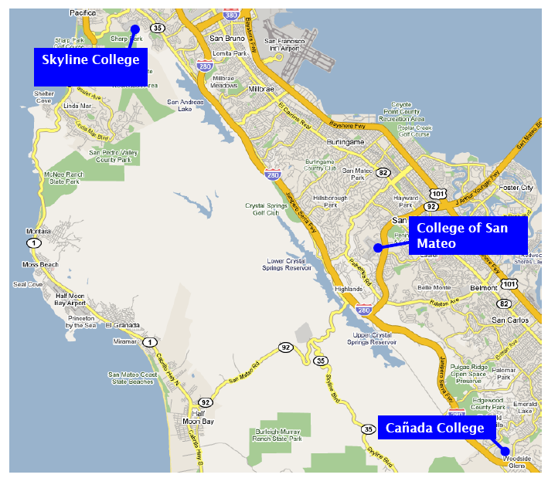
San Mateo County Map

Slide 4
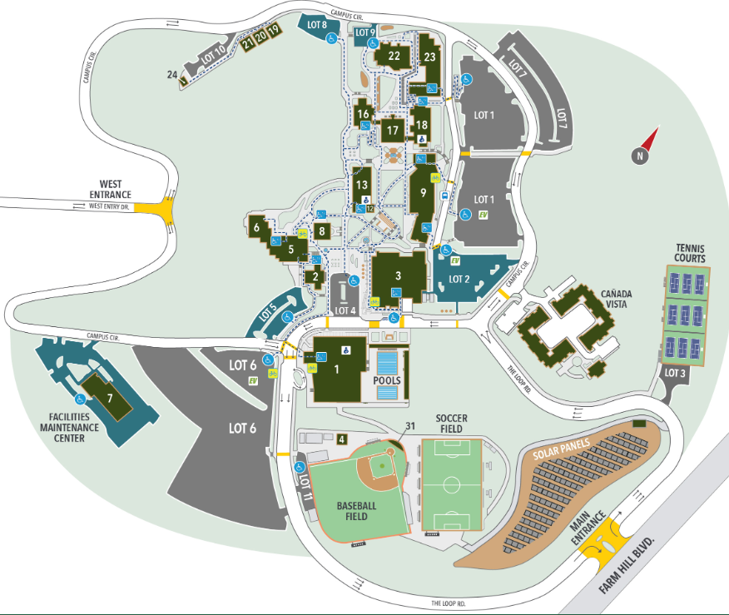
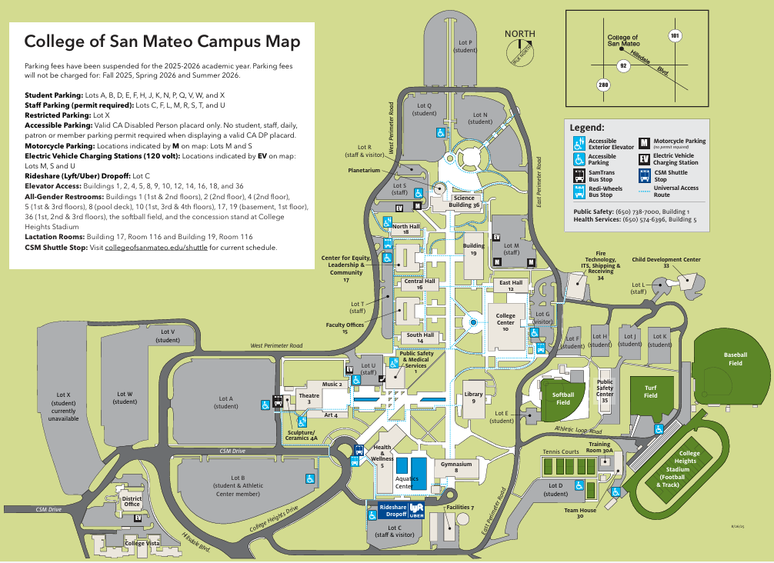
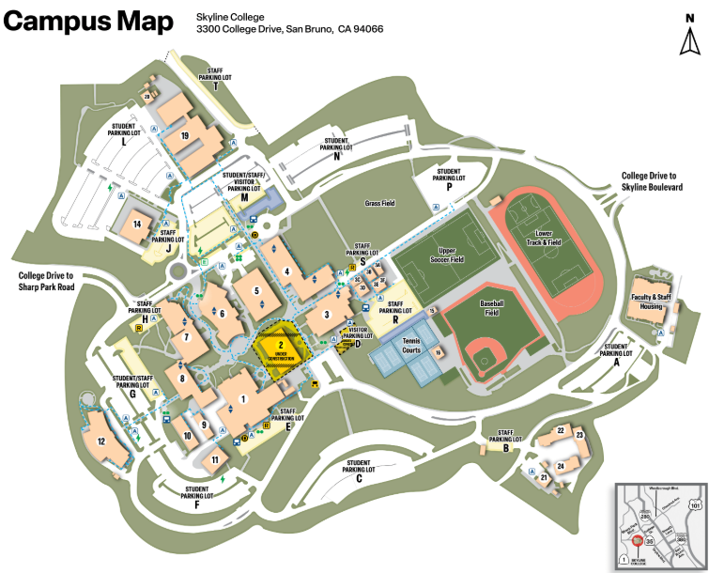
SMCCCD Campus Maps

Slide 5
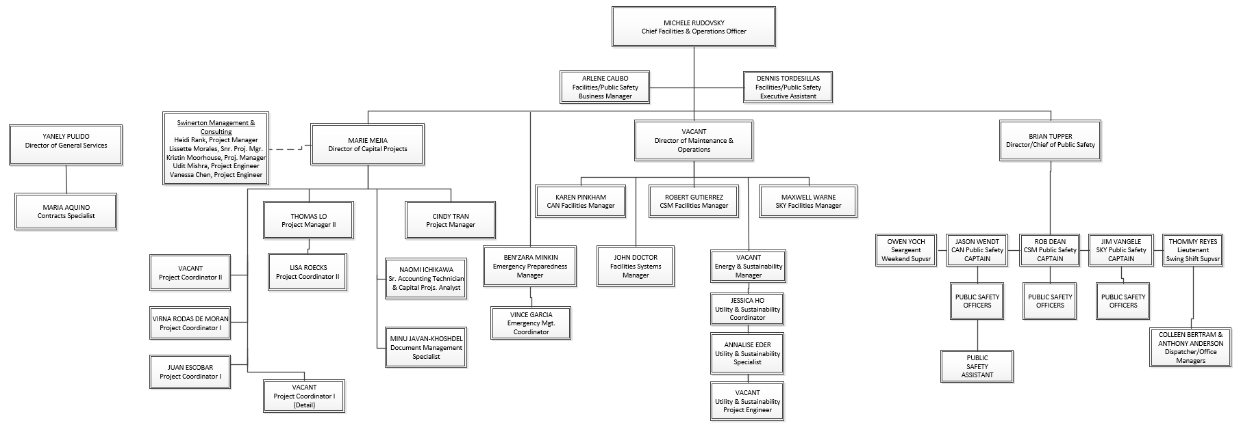
FPMO/DPS Organizational Chart

Slide 6
District Demographics
 | Campus Acreage | Gross Square Feet | Assignable Square Footage | Buildings | Parking | Student Headcount (Spring 2025) | Student FTES (Spring 2025) | Admins, FT/PT Faculty & Staff (Fall 2024*)
Cañada College | 124 | 451,335 | 298,140 | 34 | 2,025 | 7,108 | 1,955 | 357
College of San Mateo | 150 | 710,169 | 482,655 | 38 | 3,737 | 10,127 | 3,790 | 568
Skyline College | 102 | 560, 502 | 380,893 | 36 | 2,356 | 10,539 | 3,550 | 486
District Office | Incl. in CSM | 24,929 | 15,788 | 1 | Incl. in CSM | N/A | N/A | 297†
TOTAL | 376 | 1,746,935 | 1,177,476 | 109 | 8,118 | 27,774 | 9,295 | 1,708
Notes:
Slide 5 – Parking includes CAN lot 6 and CSM Edison lot. GSF and ASF will include CAN B1, Team house 3

Slide 7
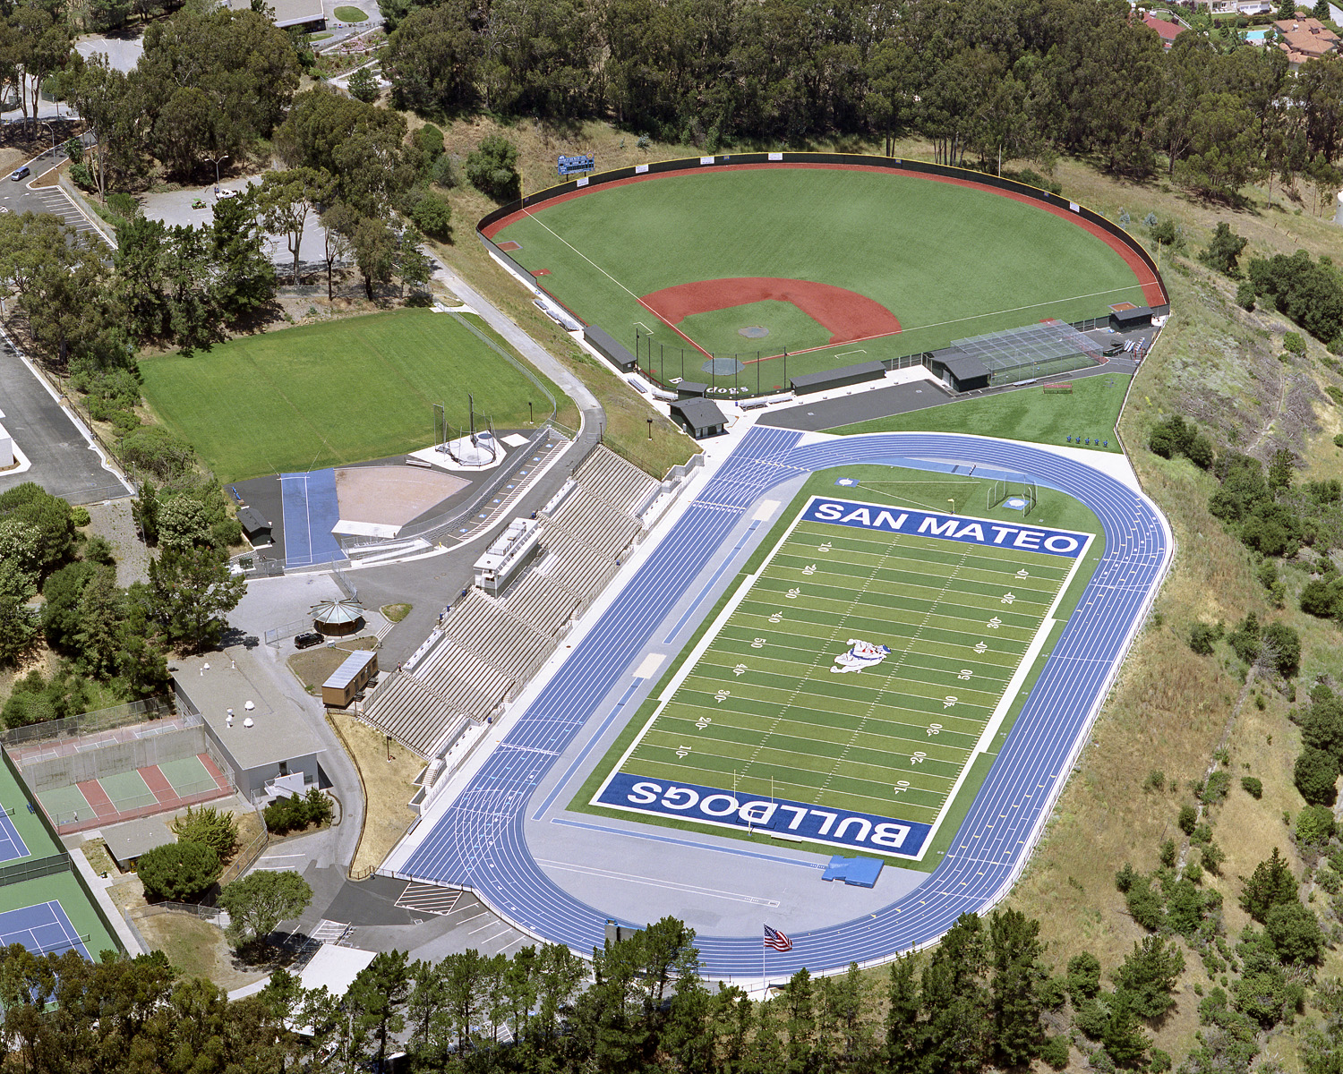
SMCCCD Assets Portfolio
Exterior Environment
  3 campuses totaling 376 acres
    144 acres are actively maintained
  66 parking lots, 9,210 parking spaces, with associated wheel stops, striping and pavement markings
  7.6 miles of roadway
  48+ miles of underground pipeline (for electrical, communications, sanitary and storm drain, water supply, gas, irrigation)
  over 3,000 exterior light fixtures
  10 sports fields (8 synthetic) and 2 tracks
  38+ acres of landscaped areas
  22 tennis courts
  4 swimming pools & 7 fountains
  DW Rolling Stock: 138 (Facilities 122, Public Safety 16)
  93 Electric Vehicle Charging Stations

Slide 8
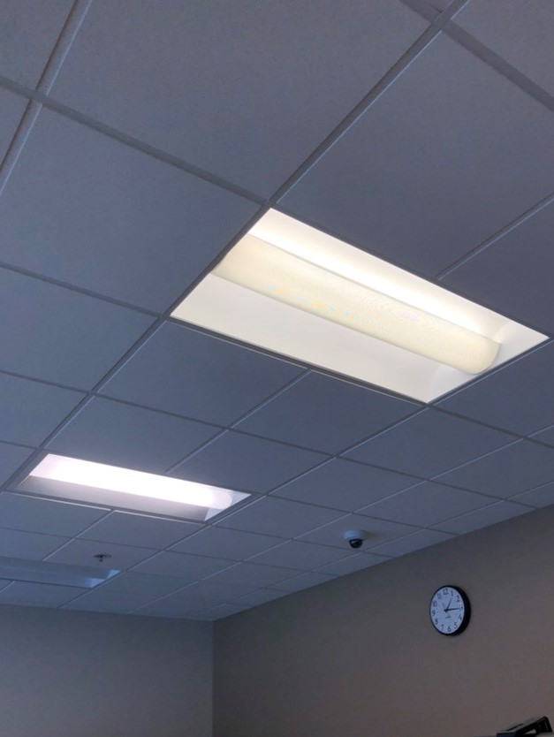
SMCCCD Assets Portfolio
Interior Environment
  100+ buildings with over 1.6M GSF
    ~173 general lecture classrooms
    ~165 labs
    ~760 offices/administrative spaces
  107 roofs
  48 elevators
  3,977 interior and exterior doors
  13,442 windows
  588 pieces of mechanical equipment (air handlers, pumps, boilers, chillers, fans, transformers)
  22,050+ interior lights
  251 restrooms (with multiple sinks, toilets, urinals in each, ADA)

Slide 9
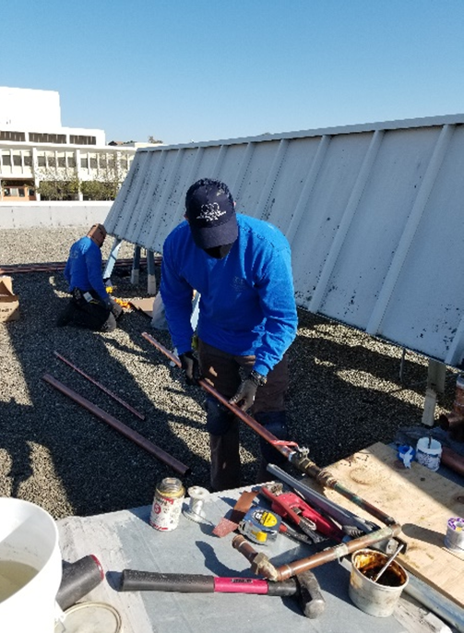
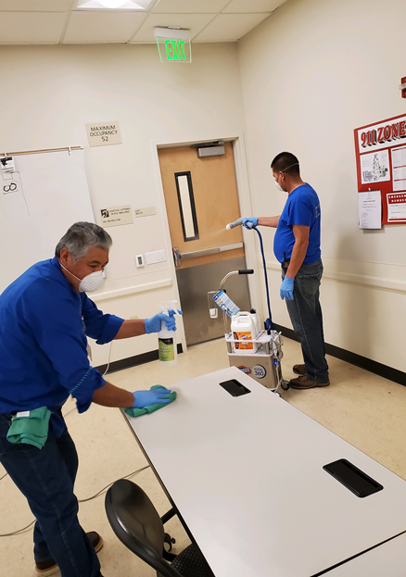
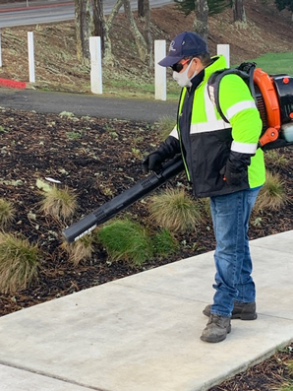
Maintenance & Operations Expectations
APPA Standards
APPA Standards provide information about:
  Levels of service, space categories, cleaning frequencies, and measurable work assignments.
  This information is essential to create accurate and equitable staffing assignments, performance metrics, and communicate expectations.
APPA recommends Level 2 as the reasonable standard
Facilities is staffed to Level 3
Custodial
Grounds keeping
Engineering

Slide 10
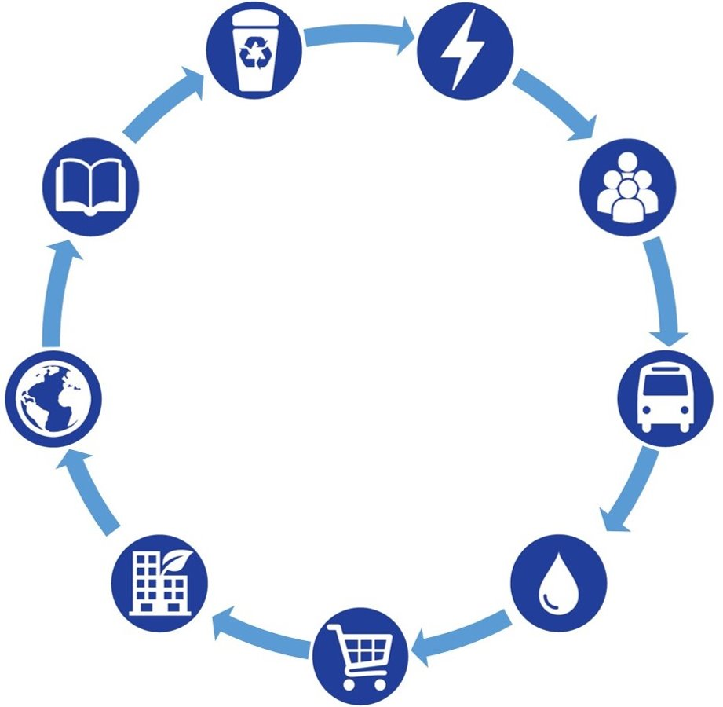

Sustainability
Notes:
Good afternoon everyone and welcome to the District! My name is Jessica Ho, I'm the Utility & Sustainability Coordinator and I've been at the district for a little over a year. In the next ten minutes I will introduce you to the Sustainability Team, our vision, current projects & how you can get involved. Please feel free to put questions in the chat as we go along and I will address at the end.

Slide 11
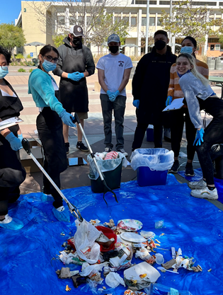
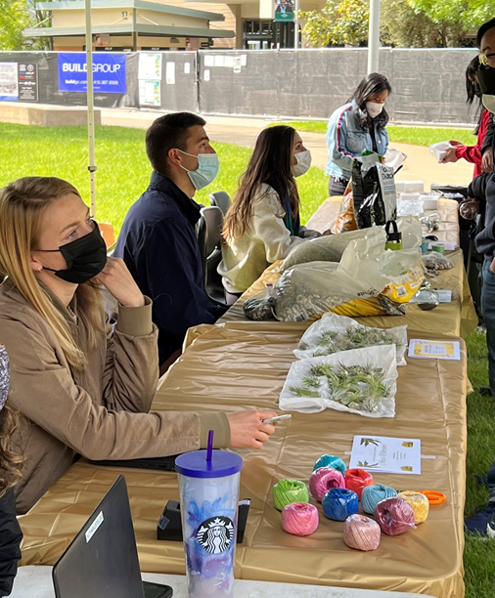
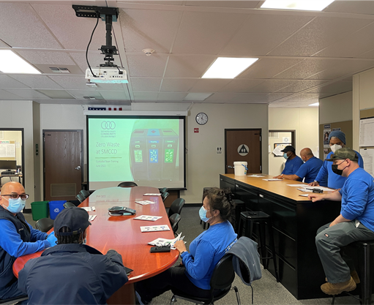

District Sustainability Team
Jessica Ho, hojessica@smccd.edu
Utility and Sustainability Coordinator
Annalise Eder, edera@smccd.edu
Utility and Sustainability Specialist
Notes:
The District Sustainability team is made up of two full time staff and two Climate Corps fellows, and works within the Facilities department to meet various resource consumption and energy efficiency goals. Reach out to any of us! We have been working on programs to lower the Districts emissions and meet our waste, water, and energy usage goals.

Slide 12
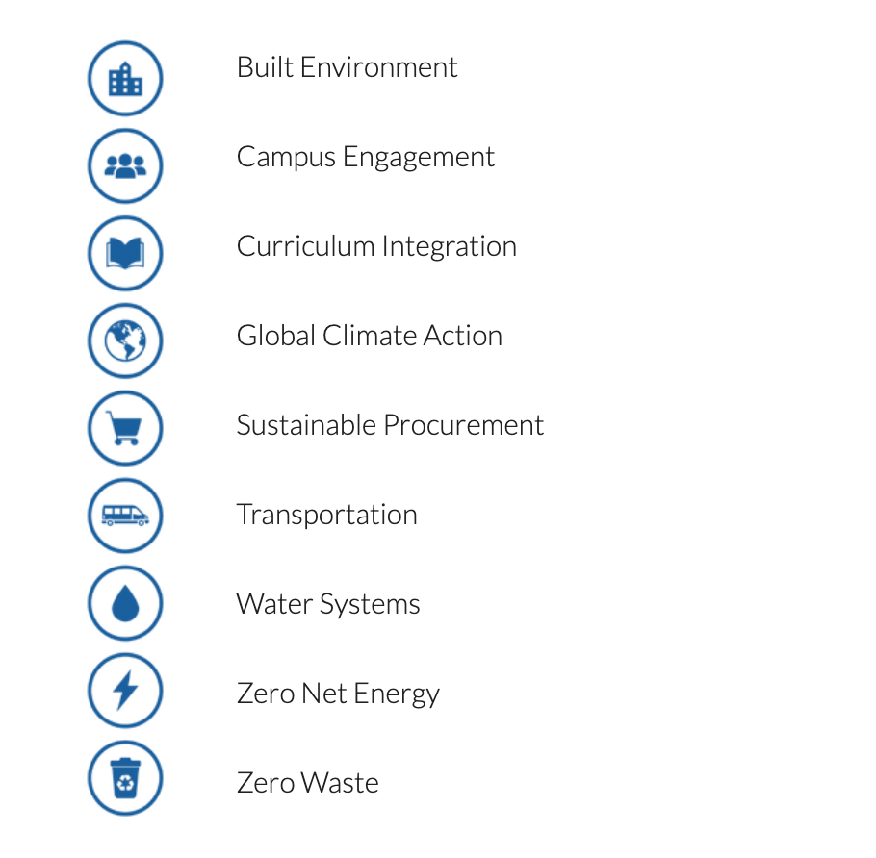
Sustainability Programs
Notes:
Our main sustainability programs were formed by the District-wide and campus sustainability committees over many years of collaboration and planning. You can explore each of these programs on our site where you will find our overall goal for these programs, project specifics, background information as well as campus statistics that we update on a regular basis.
We are working hard to promote projects that will reduce our district’s emissions, however it’s equally important to us that we engage and empower everyone on our campuses, students, staff and faculty alike while also addressing social inequities and environmental justice and you’ll see that embedded throughout these projects.

Slide 13
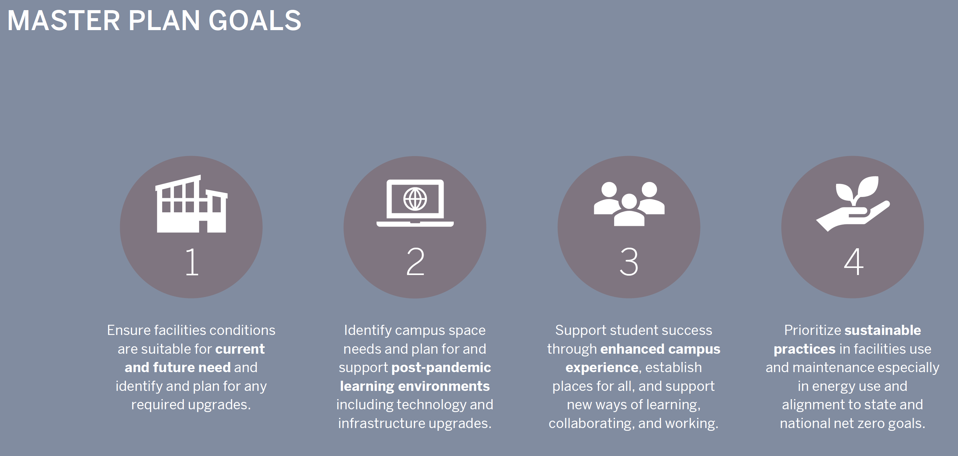
Districtwide Facilities Master Plan

Slide 14
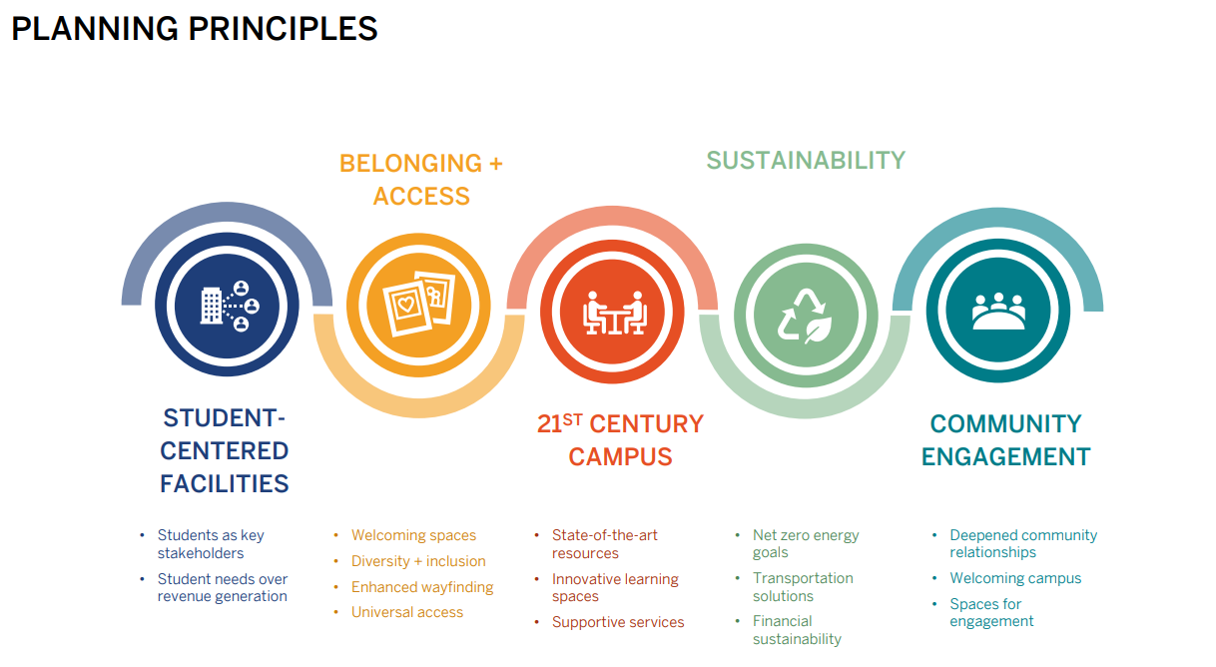
Districtwide Facilities Master Plan

Slide 15
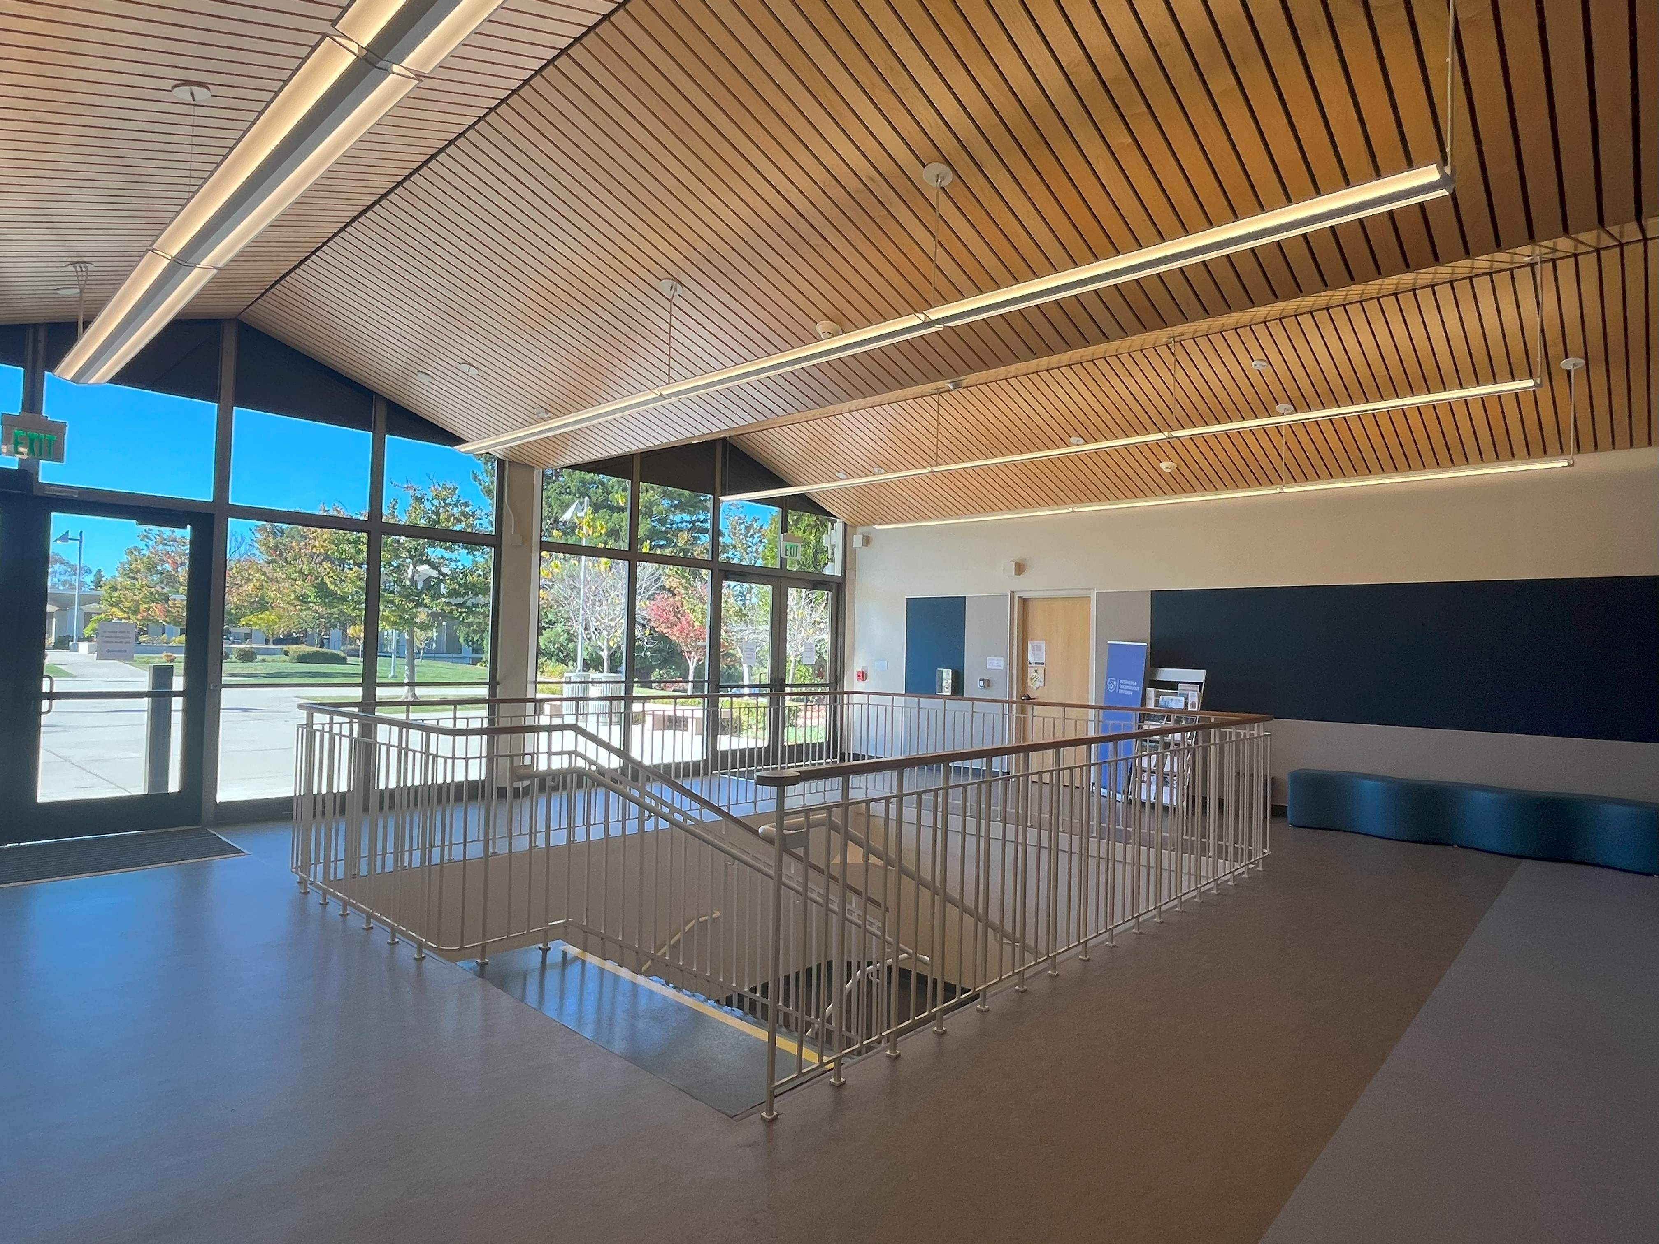
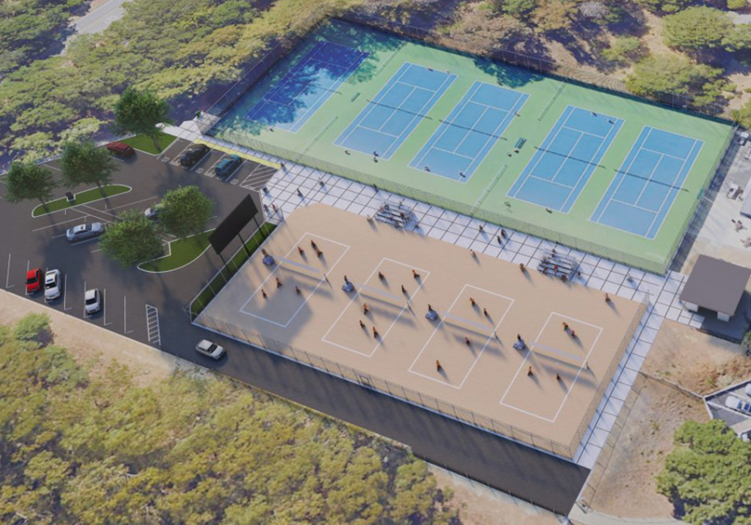
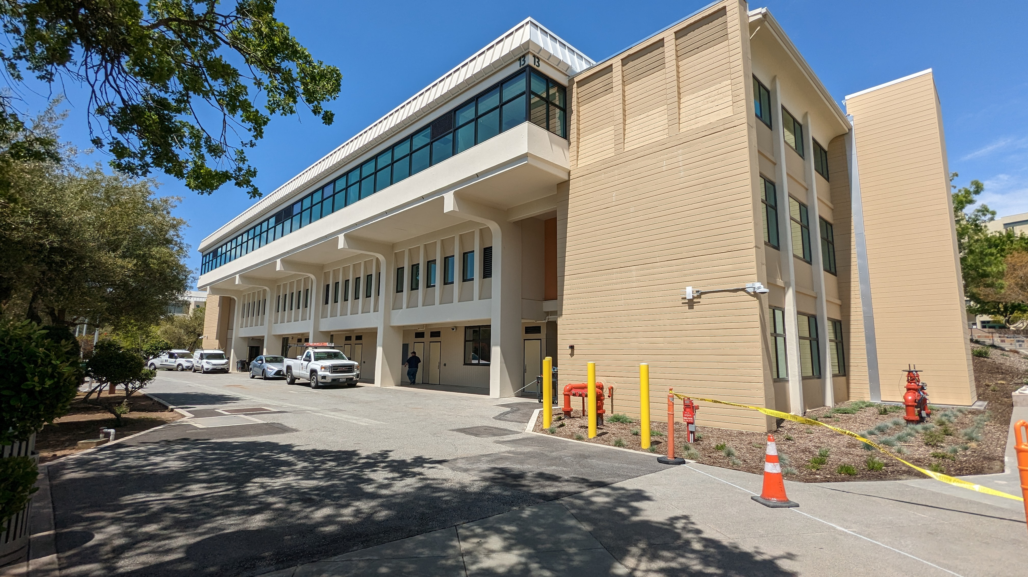
CIP3 In-Progress Projects
CAN B13 Multiple Program Instructional Center (State FPP)
CAN Sports Fields Replacement
CSM B9 Library Upgrade
CSM B19 Emerging Technologies Renovations
CSM B30 Team House
CSM B36 Mechanical Upgrade
CSM Beach Volleyball
CSM B19
CAN B13
CSM Beach Volleyball

Slide 16
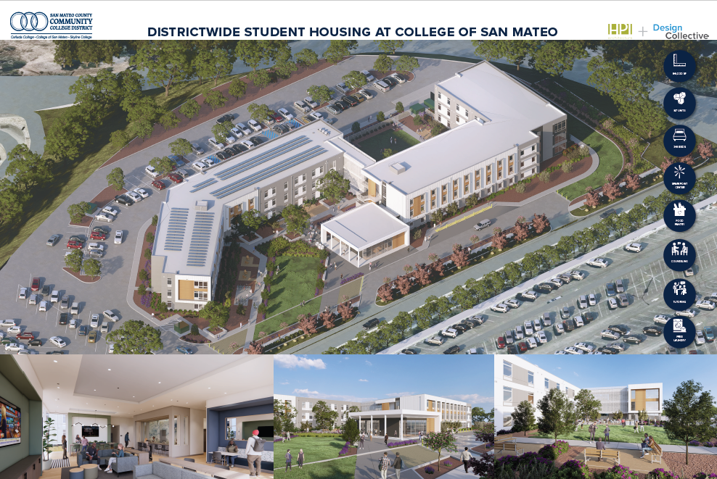
CIP3 In-Progress Projects
SKY B1 Renovations
SKY B3 & B7 Exhaust Fan and B7 HVAC Replacement
SKY B2 Modernization
SKY B6 Chiller Replacement
SKY Distributed Antenna System (DAS)
SKY Protruding Objects Project
SKY Sports Fields Replacement
DW Replacement of Irrigation System
DW Student Housing at CSM
DW ADA Transition Implementation & Signage Project
DW Facilities Masterplan Amendments and Space Utilization

Slide 17
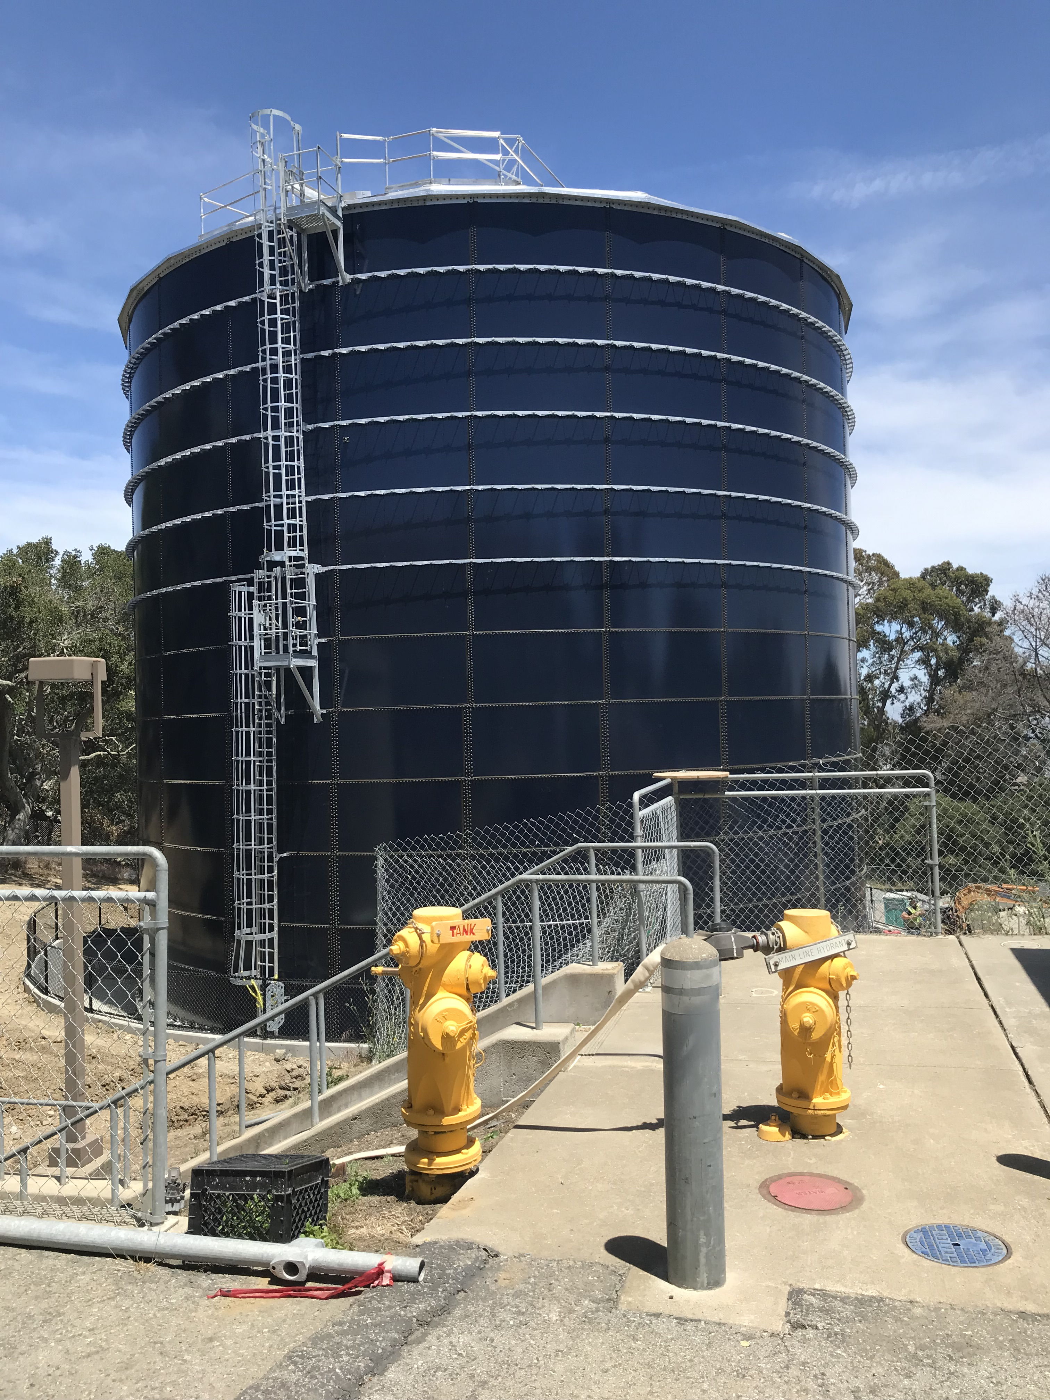
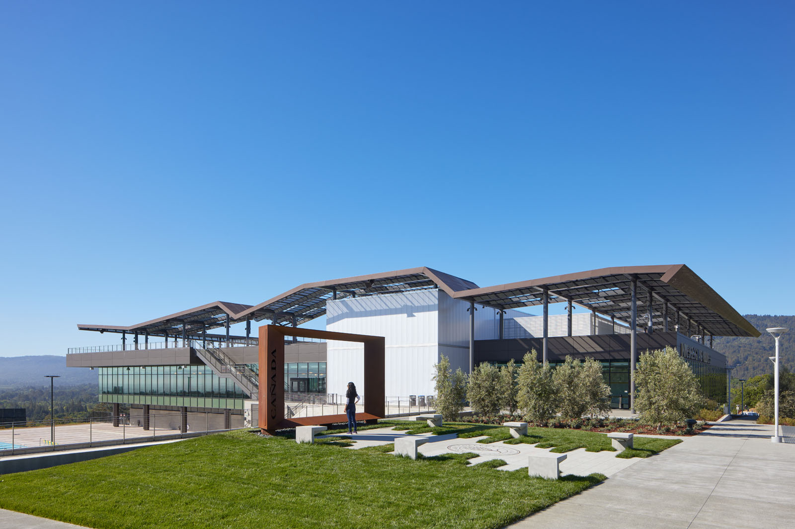
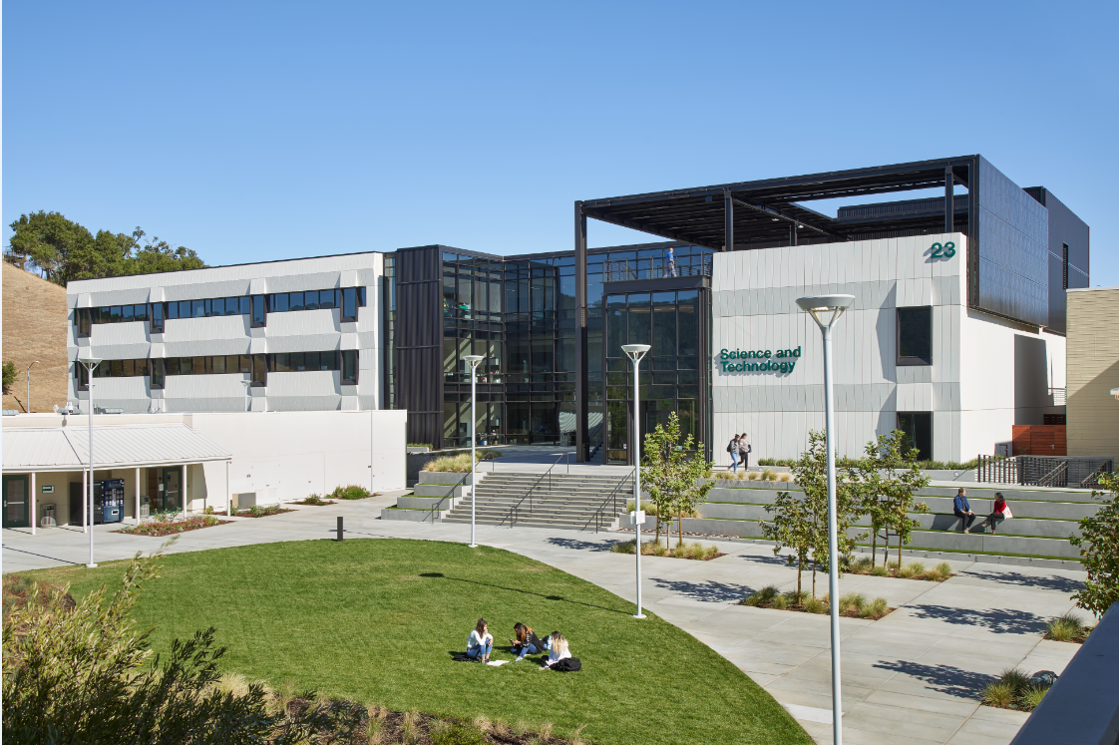
CIP3 Completed Projects
CAN B1 Kinesiology & Wellness Center and Gym Art
CAN B2 Package AC Unit Replacement
CAN B3 Exterior Doors
CAN B8 Generator Upgrade
CAN B9 Reconfiguration (Student Services)
CAN B22 (PSD, ECE, Animation Labs, Swing Spaces)
CAN B23 Science & Technology
CAN The Grove Furniture Refresh
CAN Hillside Erosion Mitigation
CSM B3 Theater Seating/AV/Lighting Upgrade
CSM B5 Healthcare Center Relocation
CSM B8 Clock Display
CSM Water Tank
CAN B1 Kinesiology & Wellness Center
CAN B23 Science & Technology

Slide 18
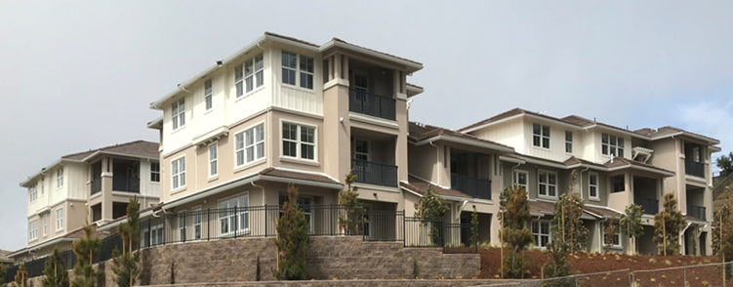
CIP3 Completed Projects
CSM Football Turf & Track Replacement
CSM Edison Lot
CSM Water Tank (State FPP)
CSM Coastside Facility
DW Fire Alarm Control Panel Upgrade
DW LED Interior Lighting Upgrade
DW Irrigation Upgrade
DW Door Hardware Upgrade
DW Facilities Master Plan
DW Classroom Tech Upgrade to Hyflex
DW Network Upgrade
DO EVCS Replacement
SKY B1 Facelift – Social Science/Creative Arts
Department Space Refresh – Non DSA
SKY B19 Pacific Heights Swing Space (Passport, GLPS, NETX, ITS, B2) & Electrical/Ventilation Upgrade
SKY College Ridge (Faculty housing / Parcel B)
SKY Isolation Valves & Fittings Replacements Project
SKY Lot L EV Charging Stations Replacement
SKY College Ridge (Parcel B)

Slide 19

Department of Public Safety

Slide 20
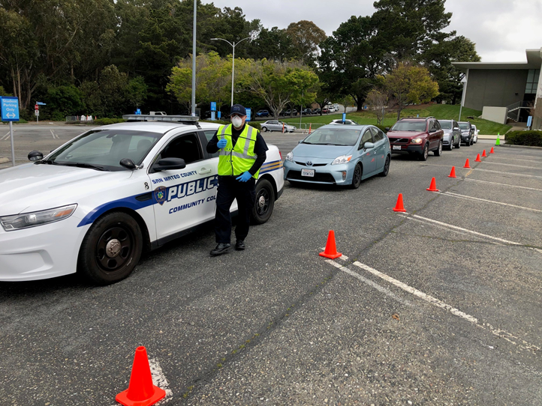
Public Safety Overview
    Enhanced Training
      COVID – 19 Safety Procedures
      Entire Department is trained and certified under SB390 (required by 07/2021)
      Mandatory POST academy certification for all new officers
      New and refresher POST and Emergency courses
      MOU with local Law Enforcement / OES / PG&E / Red Cross
      Conflict resolution, campus crime prevention, generational differences, implicit bias, conflict management/de-escalation, Narcan
    Enhanced Coverage
      Provide 24/7 coverage District Wide
      Improved emergency and activity response time
      Provide a more visible presence of Public Safety Officers
      Increased enforcement in Campus Parking Lots
      Promote Safety Escort Services Program
      Increased revenue through improved staffing and management

Slide 21
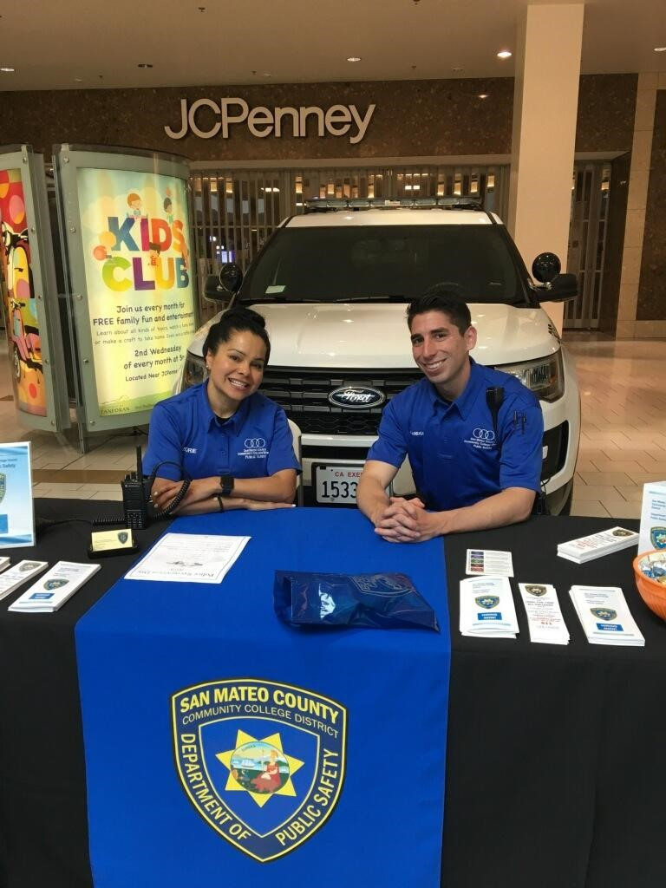
Duties & Responsibilities
Maintain and Enforce Public Safety
Parking Enforcement
Community Policing
Medical Emergencies / First Aid / CPR / AED
Handle Dynamic Situations
Earthquake / Fire / General Emergency Evacuations
Emergency Preparedness Training
Liaison with Local Law Enforcement and Fire Department
Safety Escort Service
Lost and Found
General Public Relations

Slide 22

Campus Alert Systems
Emergency Announcement System (EAS)
  Monthly Test
RAVE – Emergency Text Message Notification
  26,925 Subscribers District Wide
UHF Radios – Communication District Wide
  Monthly Tests
  250+ Radios District Wide
Public Safety Website Homepage / Facebook / Twitter
  http://www.smccd.edu/publicsafety/
VEOCI – Virtual Emergency Operations Center
County
  SMC Alerts via Email and Text

Slide 23
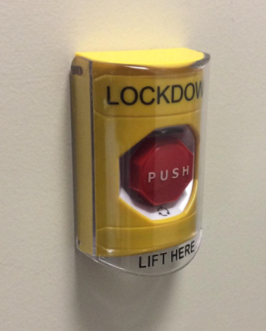
Public Safety Technology
Video Cameras
  800+ District Wide
ACAMs
  Employee Photo ID
  1,281 Points District Wide
AEDs
  70+ Units District Wide
911 System
Duress Buttons
  Text
  Email
  66 District Wide (CSM 38, CAN 14, SKY 14)
Lockdown Button

Slide 24
Safety/Emergency Response
DW / Campus Safety Committees
OSHA Compliance
  Chemical Hygiene Plan
  Hazardous Communications Plan
  Material Safety Data Sheets (MSDS)
Emergency Preparedness Training (SafeColleges)
  https://training.fema.gov/is/courseoverview.aspx?code=IS-100.c
  https://training.fema.gov/is/courseoverview.aspx?code=IS-200.c
  https://training.fema.gov/is/courseoverview.aspx?code=IS-700.b
  https://training.fema.gov/is/courseoverview.aspx?code=IS-800.c
Emergency Operations Center (EOC) - Command/Management, Operations, Planning, Logistics, and Finance
Equipment
Communications
Mandated Disaster Service Workers
MOUs - OES, Red Cross, PG&E and Local Law Enforcement
Risk Management and Compliance / Insurance / OCIP
CARES Team - President, Vice Presidents, Chief & Captains of Public Safety, Psychological Services, Counseling, and Health Services

Slide 25
Safety/Emergency Preparedness Trainings
EOC Table Top Exercises
EOC Training - ICS 100/IS 700
Confronting School Violence Training
CPR / AED Training
Public Safety Power Shutdown (PSPS)
Lockdown Drills
Great CA Shakeout Earthquake Drill
Building Captain & Floor Manager Training
FEMA Training
  Sport Event Evacuation
  Incident Management
  Enhanced Incident
  IHE 101 Developing Emergency Ops Plans
Campus Crisis Workshops
Red Cross Shelter Training
ATC Training (Post Earthquake Assessment of Buildings)

Slide 26
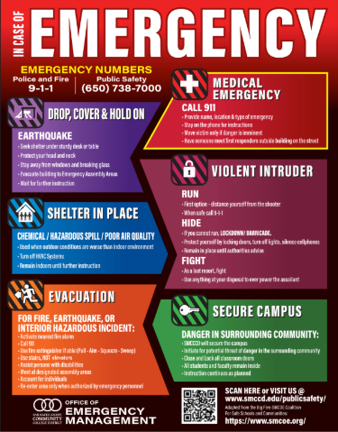
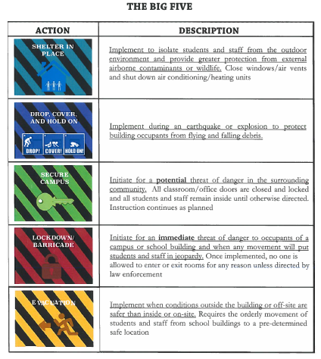
THE BIG FIVE
Shelter in Place; Drop, Cover & Hold On; Secure Campus; Lockdown or Barricade; Evacuation

Slide 27
Emergency Generators
Emergency Generator | Type | Model | Capacity
Cañada College (tow) | CATERPILLAR engine c4.4 S/N E5M02416AR | GENERATOR XQ60-6 S/N CAT00C44PGLE00844 | 60kw 75kva 208 amps 277/480v
College of San Mateo (tow) | CATERPILLAR engine c4.4 | XQ60-6 | 60kw 75kva 208 amps 277/480v
KCSM | Onan Cummings engine c4.4 | DFEG-5755667 | 350kw 75kva 105 amps Voltage/Phase/HZ 277/480/3/60
District Office | Onan Cummings engine 4.0 | DQDAA-5785992 | 250kw 312.5kva 375.9 amps Voltage/Phase/HZ 277/480/3/60
Skyline College B1 (tow) | CATERPILLAR engine c4.4 S/N E3N00326 | GENERATOR xq45 S/N GLE00808 | 45kw 208v 2PH 100A
Skyline College B6 (tow) | CATERPILLAR engine c4.4 S/N E3N00334 | GENERATOR xq45 S/N GLE00811 | 45kw 480v 3PA 100A

Slide 28
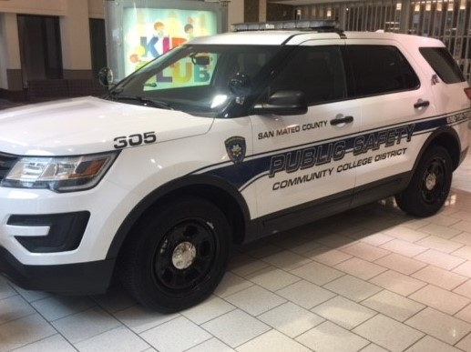
Emergency Fleet
SMCCD owns various types of vehicles located at the three colleges that could aid the community in emergency response situations to include:
  Pickups
  Vans
  Backhoes
  Flatbeds
  Gators
  Electric carts
  Chippers
  Genie Lifts

Slide 29
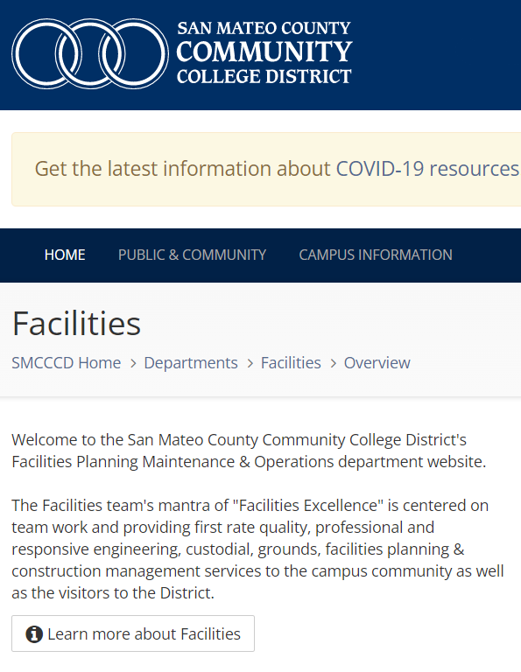
Facilities Website
smccd.edu/facilities/

Slide 30
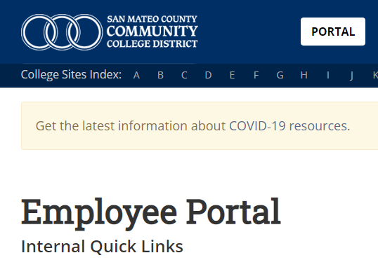
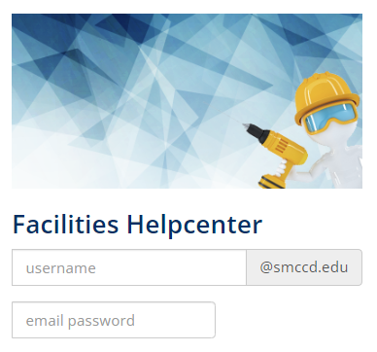
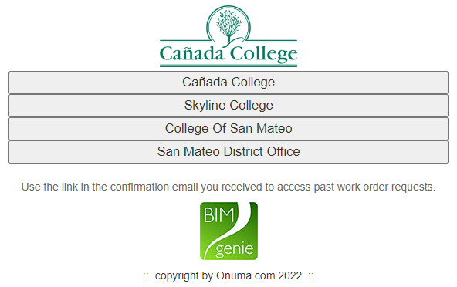
How to request a work order
Go to:
Enter email username &
Select location and
smccd.edu/portal
password
complete form

Slide 31
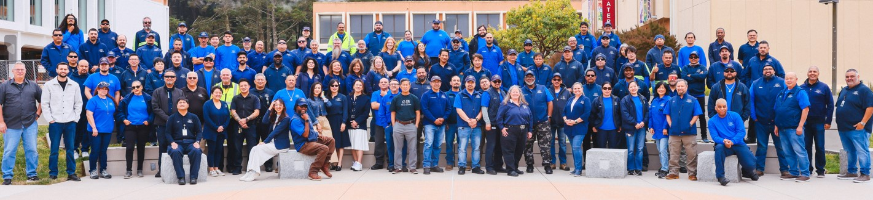
ONE TEAM!
NEW PHOTO
Facilities Excellence = Customer Service * Professionalism * Team Work * Communication
Public Safety Excellence = Safety * Education * Service

Slide 32

Facilities Planning,
Maintenance & Operations
"Facilities & Public Safety Excellence"

