Slide 1




Facilities Planning, Maintenance & Operations, Sustainability Public Safety and Emergency Preparedness
New Employee Orientation
"Facilities & Public Safety Excellence"

Slide 2
Mission Statement
The Mission of the Facilities Planning, Maintenance & Operations and Public Safety Departments is to ensure a safe, effective, and inspiring environment that supports and enhances the instructional mission and ensures student success of the San Mateo County Community College District.

Slide 3
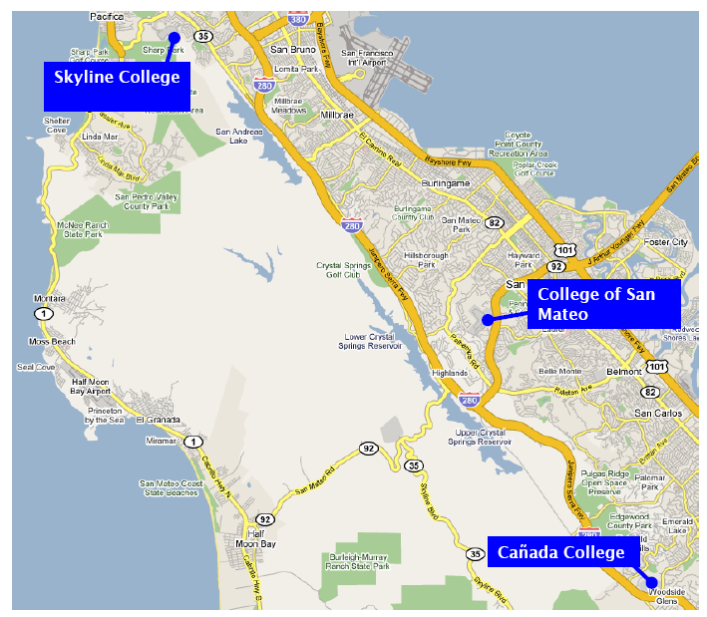
San Mateo County Map

Slide 4
Facilities Planning, Maintenance and Operations, and Public Safety Leadership Team
Michele Rudovsky
Chief Facilities and Operations Officer
Dennis Tordesillas
Facilities and Public Safety
Executive Assistant
(Vacant)
Facilities and Public Safety
Business Manager
Facilities Planning
(VACANT)
Director of Capital Projects
Facilities Maintenance and Operations
Karen Pinkham
Facilities Manager, Cañada College
Robert Gutierrez
Facilities Manager, College of San Mateo
Max Warne
Facilities Manager, Skyline College
Department of
Public Safety
(VACANT)
Director of Public Safety
Jason Wendt
Public Safety Captain, Cañada College
(Vacant)
Public Safety Captain, College of San Mateo
Jim Vangele
Public Safety Captain, Skyline College
Emergency Preparedness
Ben’Zara Minkin
Emergency Preparedness Manager
Sustainability
Jessica Ho
Energy and Sustainability Coordinator

Slide 5
District Demographics
 | Campus Acreage | Gross Square Feet | Assignable Square Footage | Buildings | Parking | Student Headcount (Spring 2026) | Student FTES (Spring 2026) | Admins, FT/PT Faculty & Staff (Fall 2025*)
Cañada College | 124 | 451,335 | 298,140 | 34 | 2,025 | 7,008 | 1,889 | 363
College of San Mateo | 150 | 710,169 | 482,655 | 38 | 3,737 | 9,167 | 3,191 | 553
Skyline College | 102 | 560, 502 | 380,893 | 36 | 2,356 | 10,878 | 3,723 | 494
District Office | Incl. in CSM | 24,929 | 15,788 | 1 | Incl. in CSM | N/A | N/A | 301†
TOTAL | 376 | 1,746,935 | 1,177,476 | 109 | 8,118 | 27,053 | 8,803 | 1,711
Notes:
Slide 5 – Parking includes CAN lot 6 and CSM Edison lot. GSF and ASF will include CAN B1, Team house 3

Slide 6
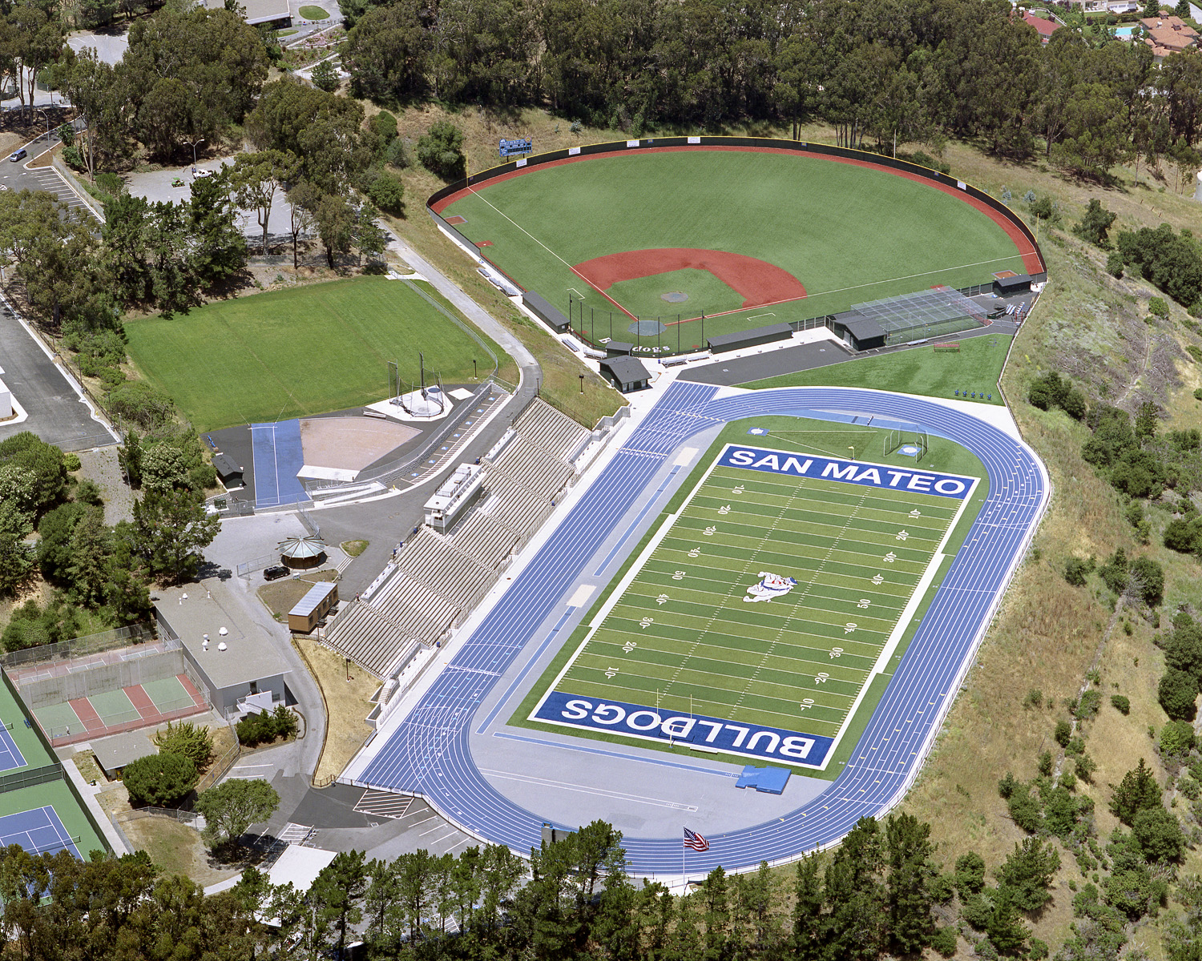
SMCCCD Assets Portfolio
Exterior Environment
  3 campuses totaling 376 acres
    144 acres are actively maintained
  41 parking lots, 7,919 parking spaces, with associated wheel stops, striping and pavement markings
  7.6 miles of roadway
  48+ miles of underground pipeline (for electrical, communications, sanitary and storm drain, water supply, gas, irrigation)
  over 3,000 exterior light fixtures
  10 sports fields (8 synthetic) and 2 tracks
  40+ acres of landscaped areas
  21 tennis courts & 9 pickleball courts
  4 swimming pools & 7 fountains
  DW Rolling Stock: 138 (Facilities 122, Public Safety 16)
  93 Electric Vehicle Charging Stations

Slide 7
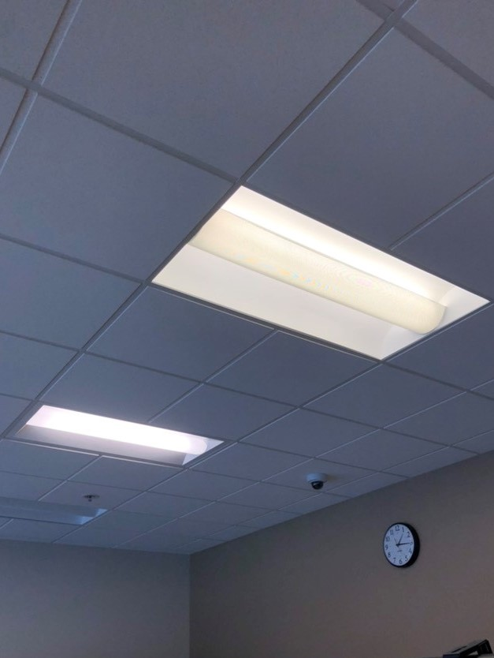
SMCCCD Assets Portfolio
Interior Environment
  100+ buildings with over 1.75M GSF
    ~173 general lecture classrooms
    ~165 labs
    ~760 offices/administrative spaces
  107 roofs
  47 elevators
  4000+ interior and exterior doors
  14,000 (approximately) windows
  600+ pieces of mechanical equipment (air handlers, pumps, boilers, chillers, fans, transformers)
  23,000+ interior light fixtures
  250+ restrooms (with multiple sinks, toilets, urinals in each, ADA)

Slide 8
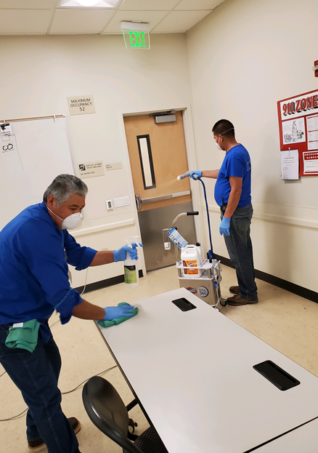
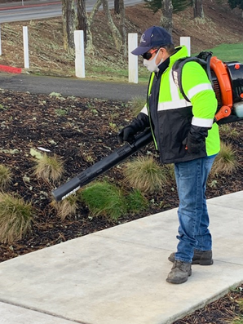
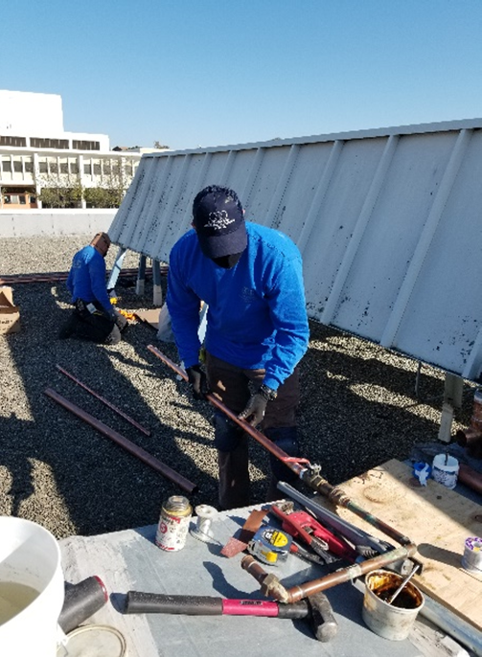
Maintenance & Operations
Services Provided
Custodial
Certified Technicians
Cleaning Services
Event Preparation
Furniture Moves
Office Set Ups
Groundskeeping
Landscaping
Tree Care
Parking Lot Maintenance
Sport Field Preparation
Event Preparation
Engineering
Building Operations
Building Maintenance
Lighting
Heating Ventilation Air Conditioning
Electrical
Plumbing
Energy Management
Vehicle Repairs
Pool Maintenance
Road Maintenance
Projects
“Facilities Excellence”
Custodial
Groundskeeping
Engineering

Slide 9
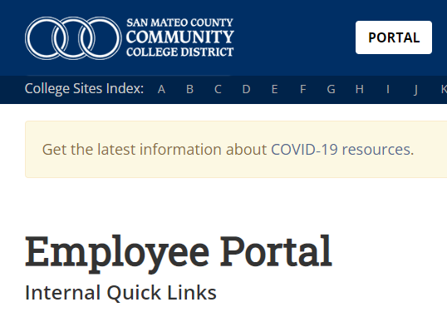
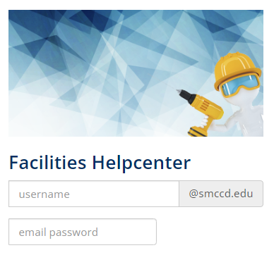
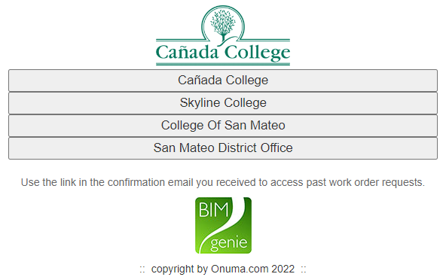
How to Submit a Work Order
Go to:
Enter email username &
Select location and
smccd.edu/portal
password
complete form

Slide 10

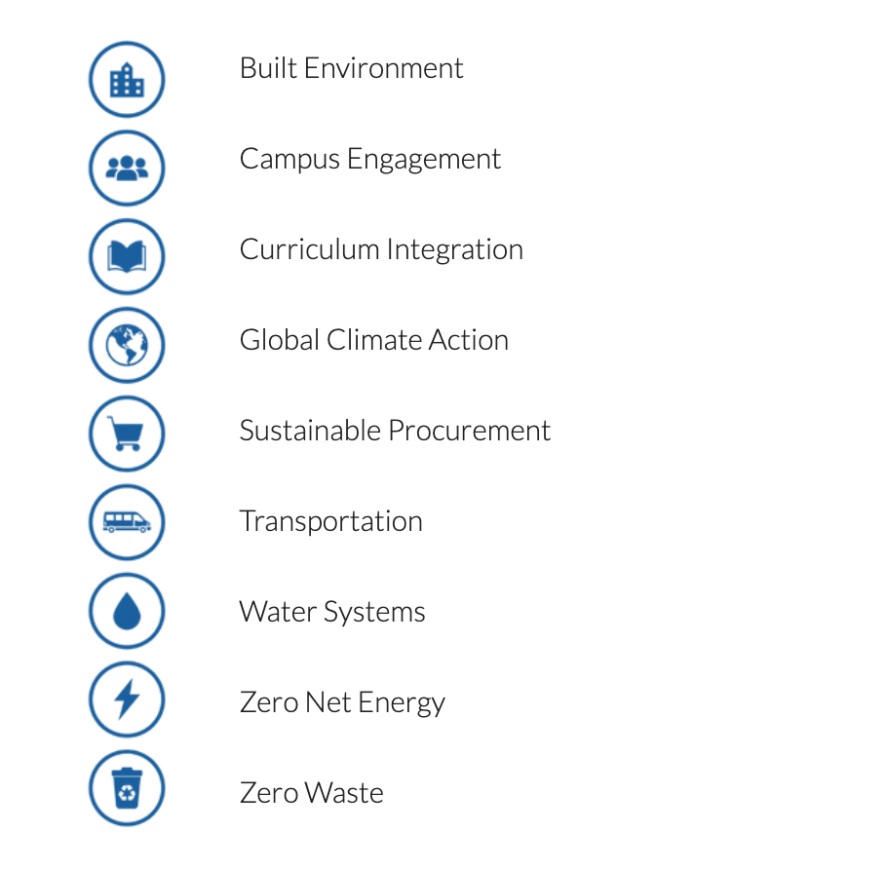
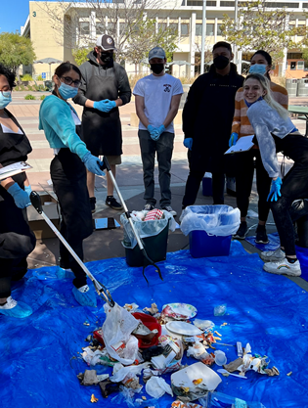
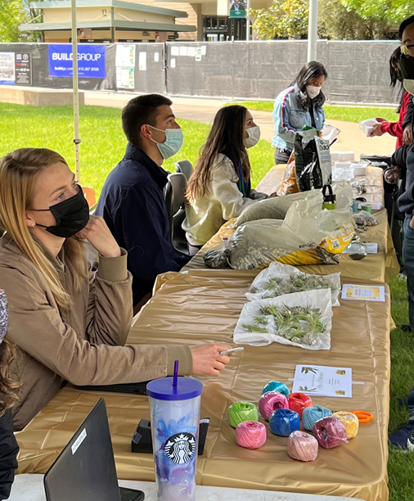
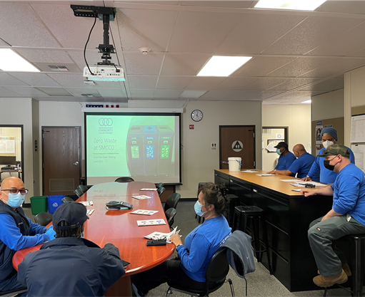
Sustainability Programs
Waste Audits
Outreach
Training
Notes:
Our main sustainability programs were formed by the District-wide and campus sustainability committees over many years of collaboration and planning. You can explore each of these programs on our site where you will find our overall goal for these programs, project specifics, background information as well as campus statistics that we update on a regular basis.
We are working hard to promote projects that will reduce our district’s emissions, however it’s equally important to us that we engage and empower everyone on our campuses, students, staff and faculty alike while also addressing social inequities and environmental justice and you’ll see that embedded throughout these projects.

Slide 11
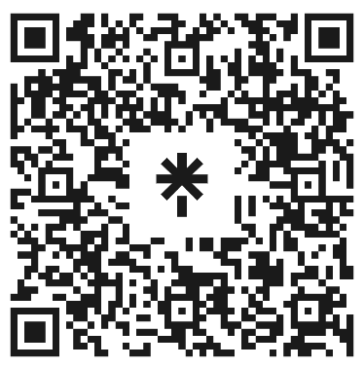
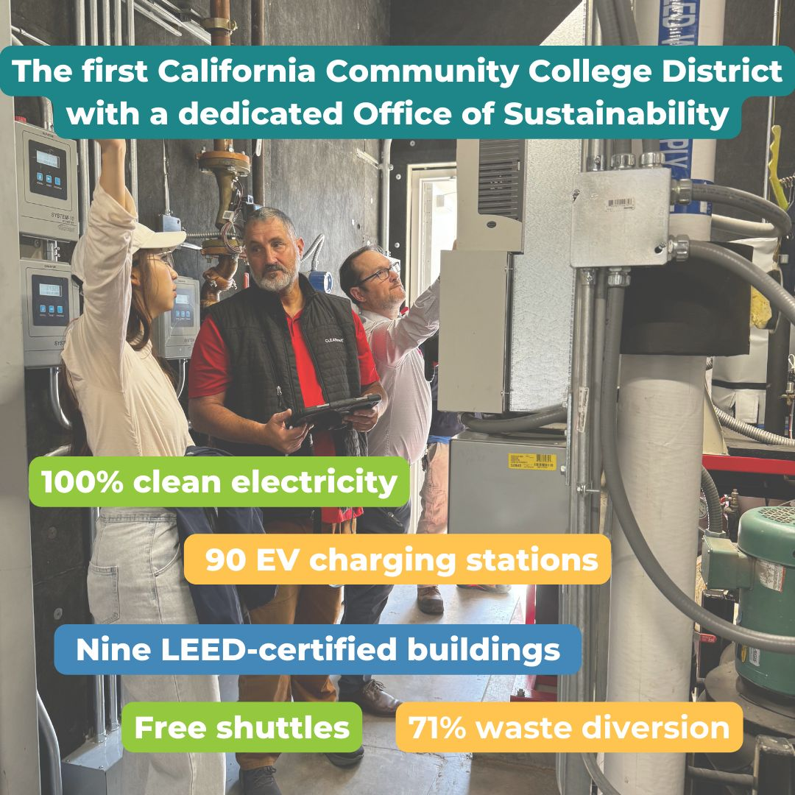
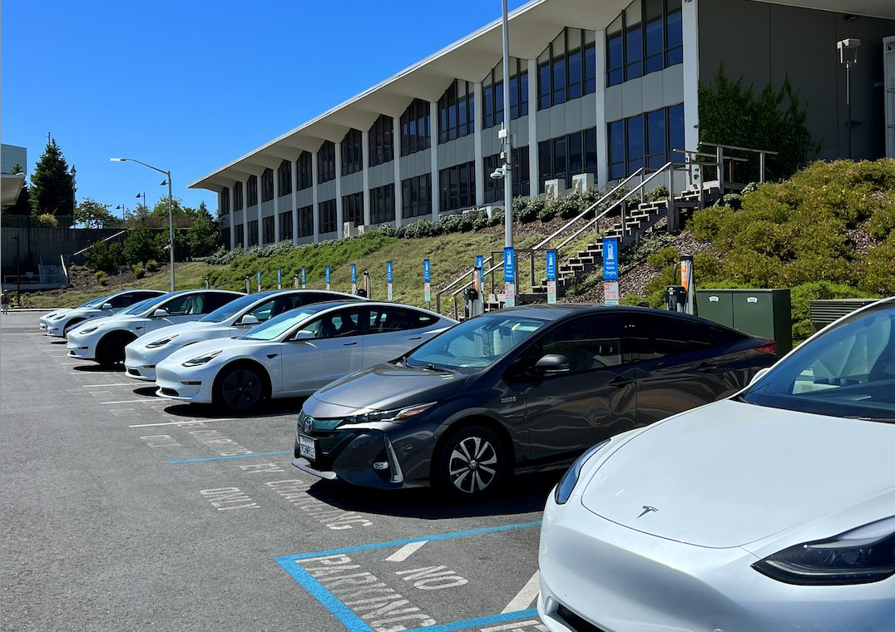
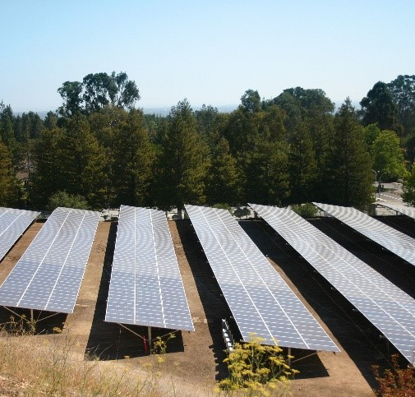
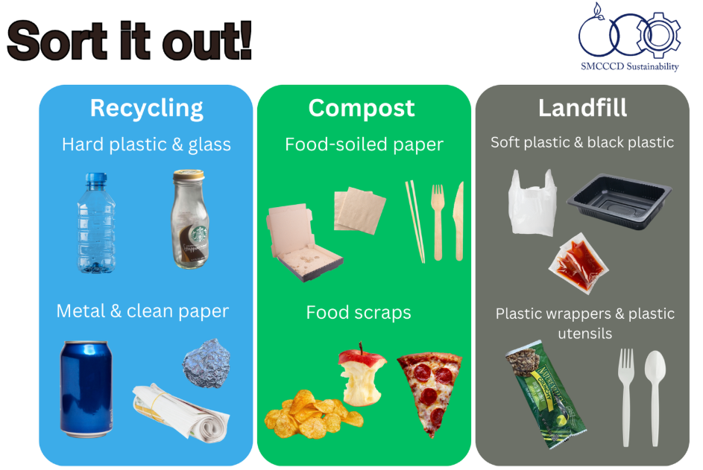

Sustainability Programs
Scan for website & Instagram!
Infrastructure Updates
Resource Conservation
Notes:
The Sustainability Department focuses on three main project areas: The first area involves campus infrastructure updates including adding & maintaining EV chargers, ensuring energy efficiency in our built environment.
Second area involves resource conservation, reducing water use, energy use, waste production etc. Just last year, we switched to procuring 100% clean electricity!

Slide 12
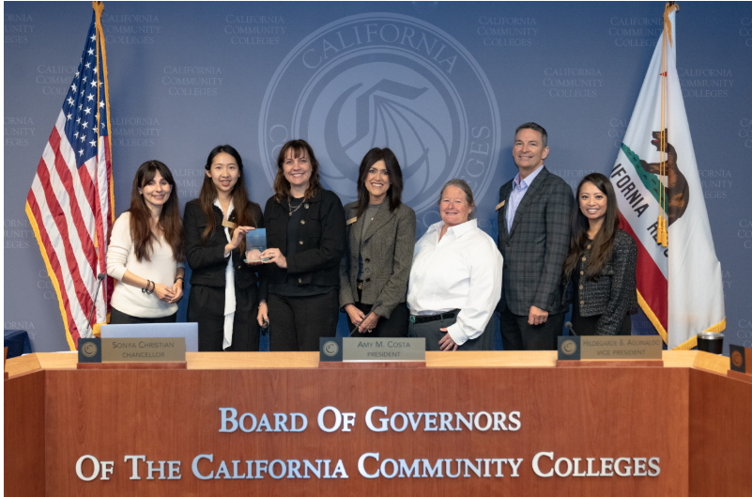
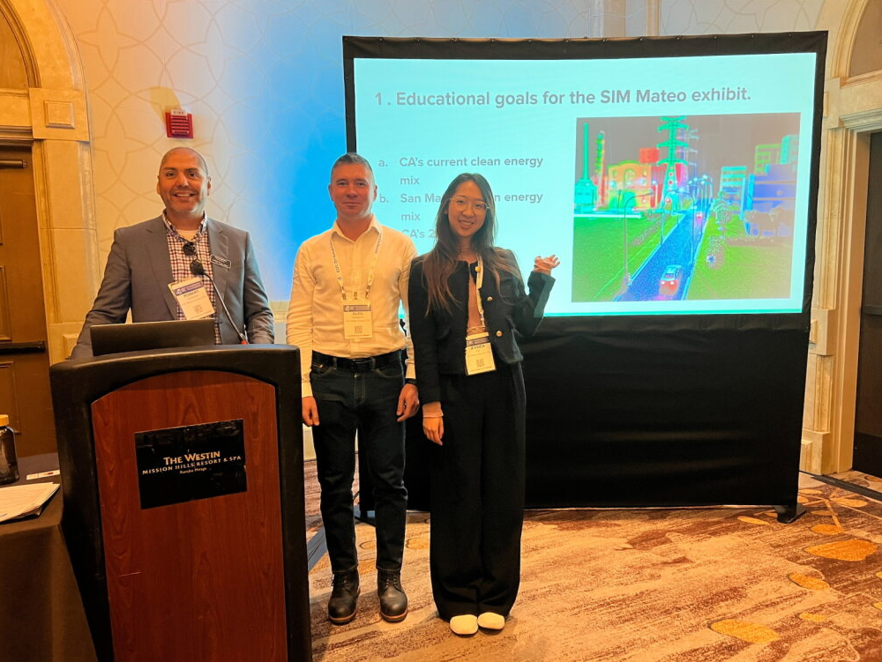
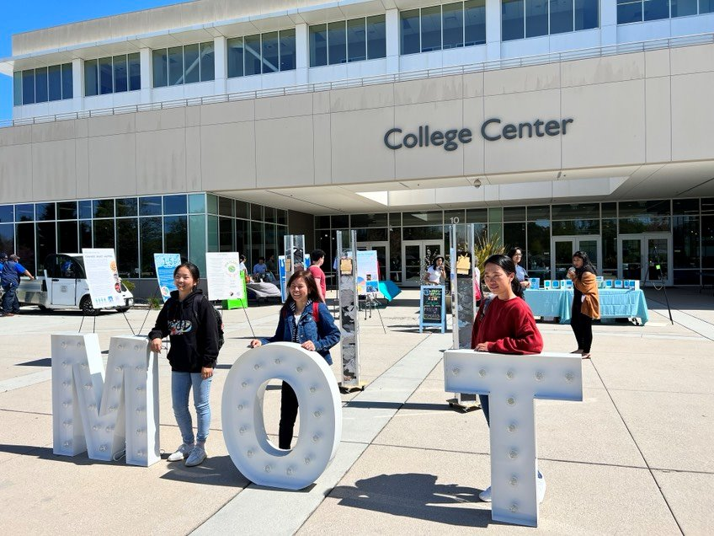
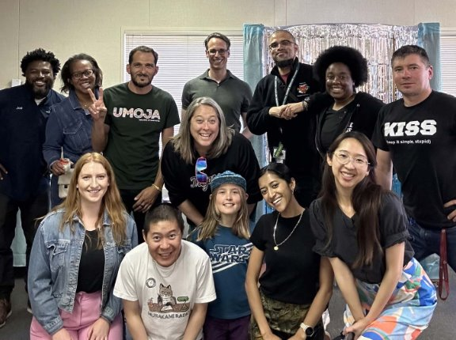
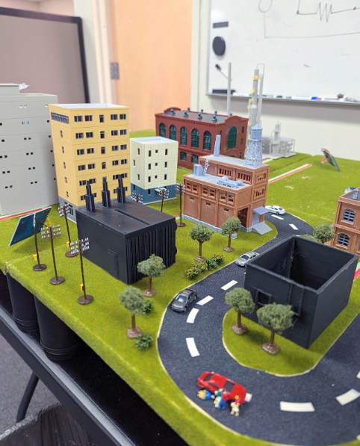
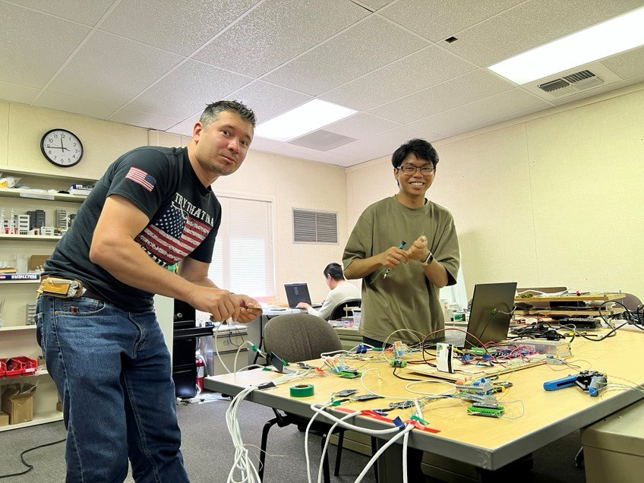

Sustainability Programs
Student Engagement Support
In & out of class presentations on any sustainability topic
Curriculum integration support
Earth Fests at all three campuses
Waste Audits
Zero Waste Ambassador Program
Sustainability Career Center at CSM B1 !
Awards
CCCCO Board of Governors Innovative Project Award (Medium District) for the California Community College system
San Mateo County Sustainability Award Winner
Green California Schools and Higher Education Leadership Award
Notes:
The third area is student engagement, they offer support for faculty curriculum development, Earth Fest students events, waste audits. Please reach out to Jessica if interested in any aspects, her team offers a variety of class presentations including campus sustainability tours.
Lastly, there is a brand new Sustainability Career Center located at CSM B1 open to all that showcases student-made interactive sustainability exhibits open for field trips!

Slide 13
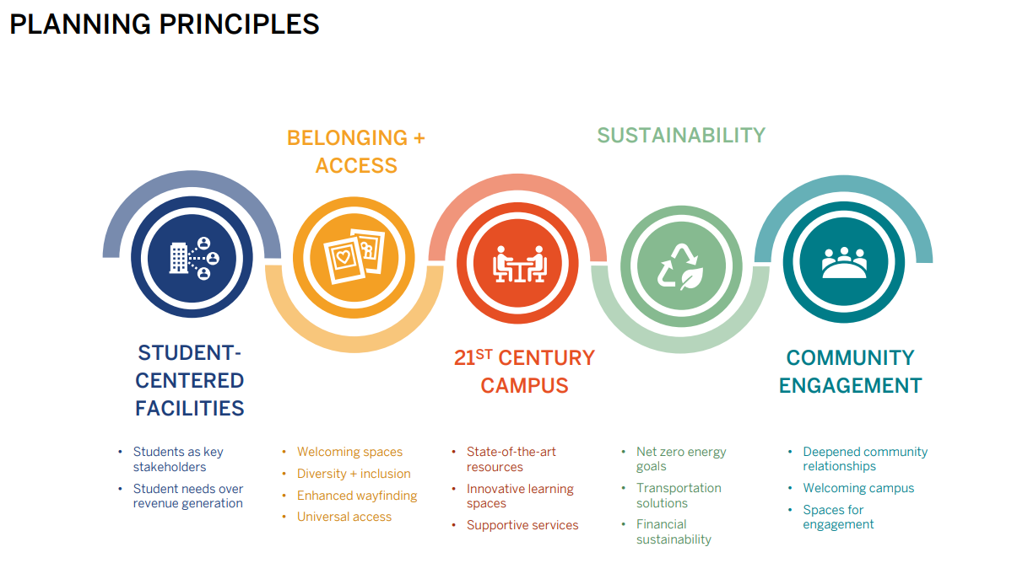
Districtwide Facilities Master Plan

Slide 14
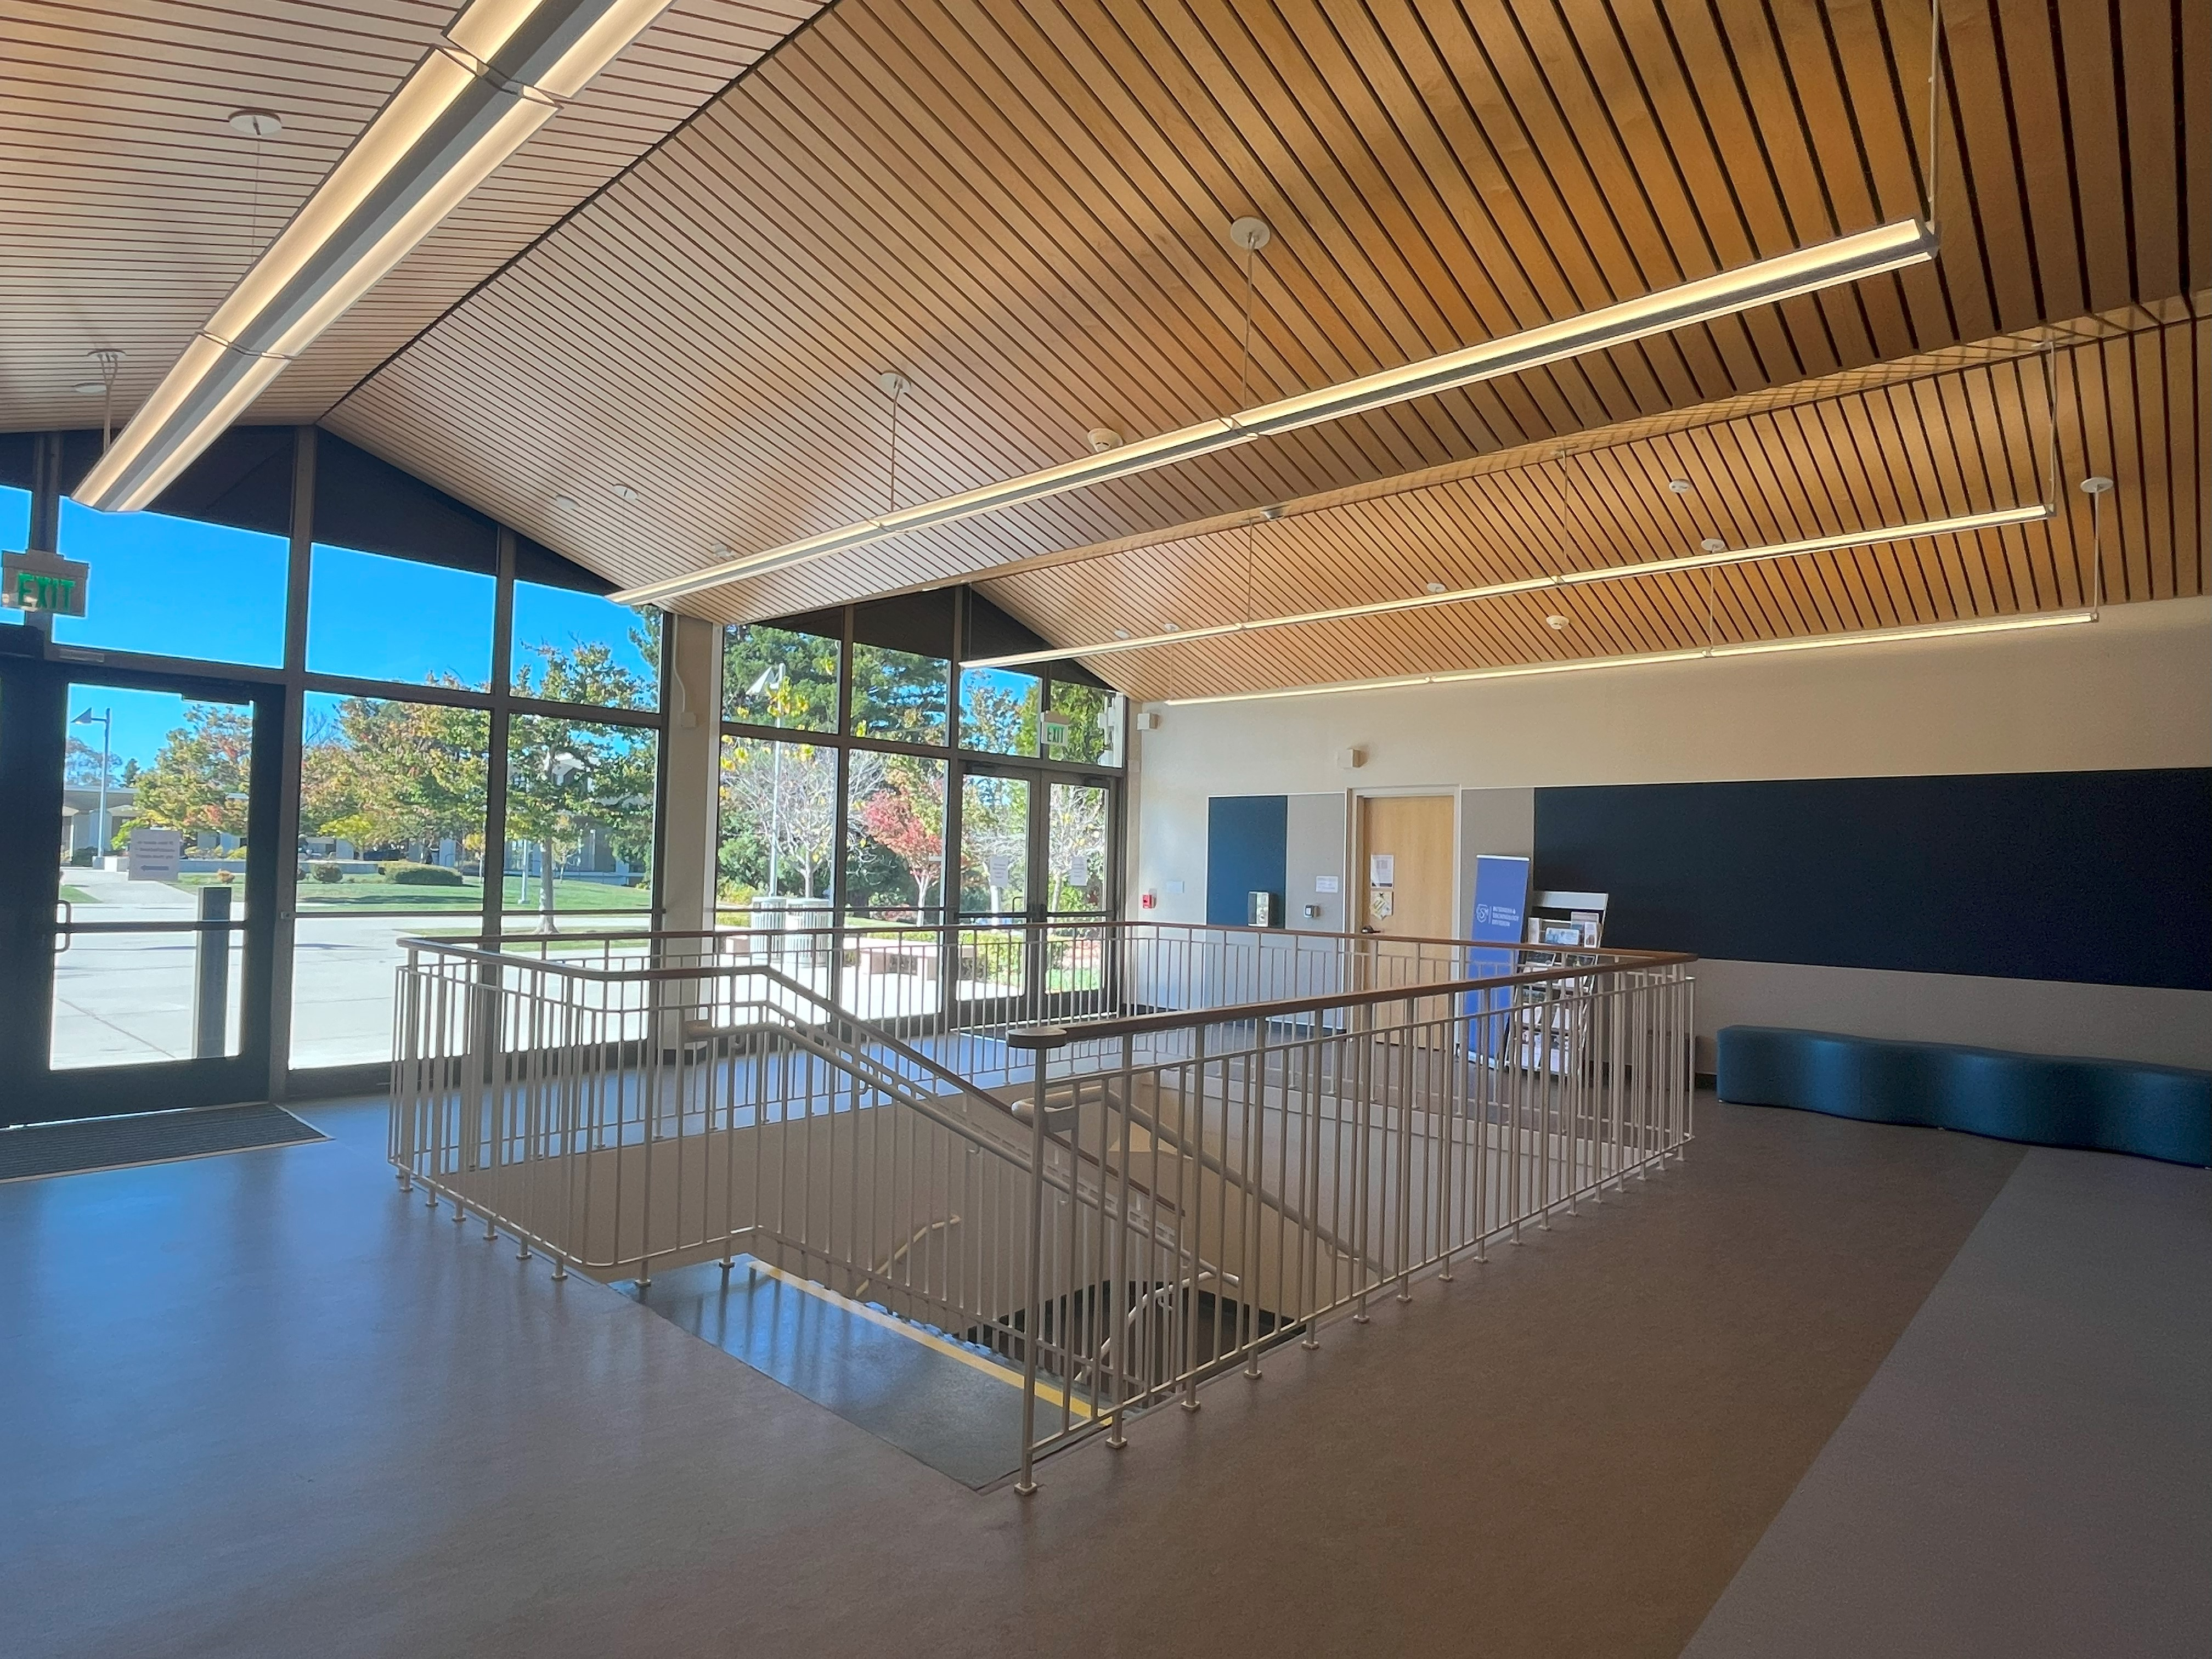
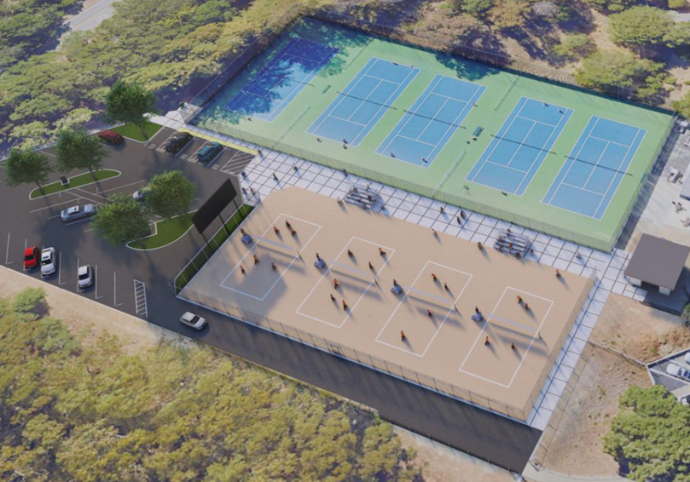
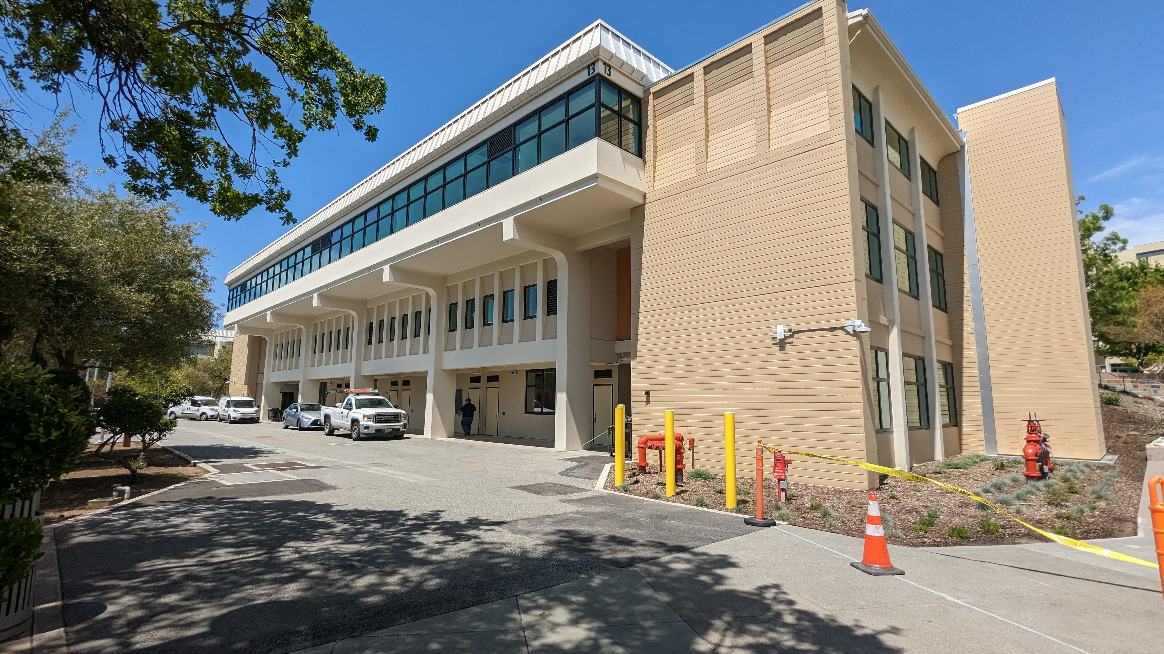
CIP3 In-Progress Projects
CAN B3 Mechanical System Replacement
CAN Erosion Mitigation
CAN Child Development Center
CAN Sports Fields Replacement
CSM B9 Library Upgrade + ADA Accessible Ramp
CSM B19 Emerging Technologies Renovations
CSM B30 Team House Lockers + Baseball Team Modular
CSM B36 Planetarium Renovation + Repair
CSM Beach Volleyball
CSM B19
CSM Beach Volleyball
CAN B13

Slide 15
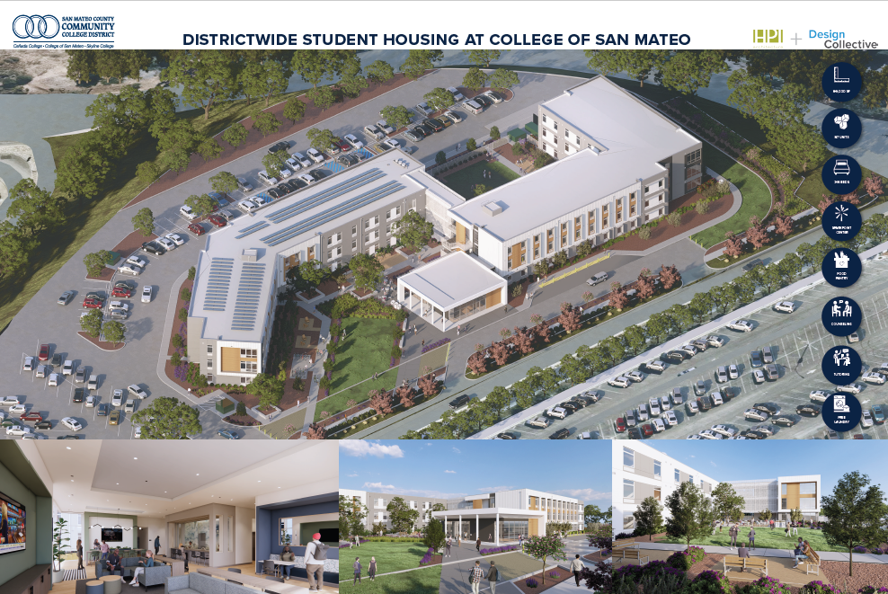
CIP3 In-Progress Projects
CSM Olympic Pool Replastering and Lighting Project
SKY New Boiler Plant Replacement FPP
SKY B2 Modernization
SKY B2 AI Innovation Hub
SKY B4 Learning Communities
SKY B6 Chiller Replacement
SKY B6/B12 AV Equipment Installation
SKY Distributed Antenna System (DAS)
SKY Sports Fields Replacement
SKY ADA Mitigation Projects
DW Replacement of Irrigation System
DW Student Housing at CSM
DW ADA Transition Implementation

Slide 16



Department of Public Safety
(650) 738-7000

Slide 17
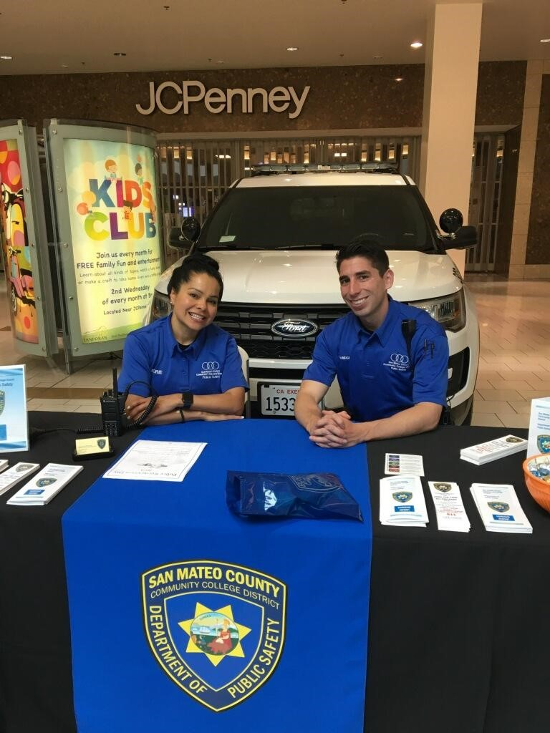
Public Safety Services
Maintain Support Campus Community Public Safety
Parking Enforcement
Community Policing
Medical Emergencies / First Aid / CPR / AED
Handle Dynamic Situations
Earthquake / Fire / General Emergency Evacuations
Safety and Emergency Preparedness Training
Liaison with Local Law Enforcement and Fire Department
Safety Escort Service
Lost and Found
General Public Relations

Slide 18
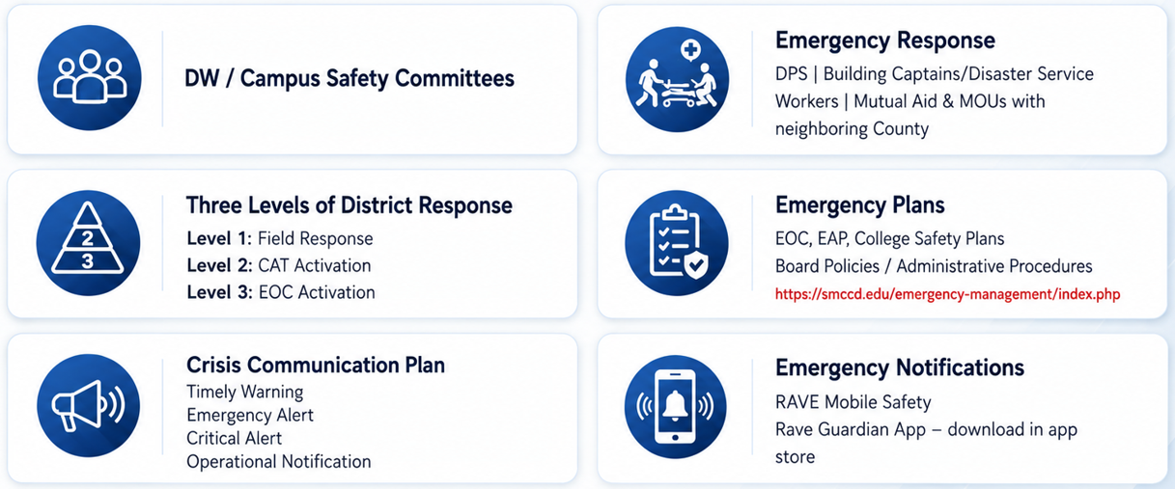
Safety and Emergency Response

Slide 19
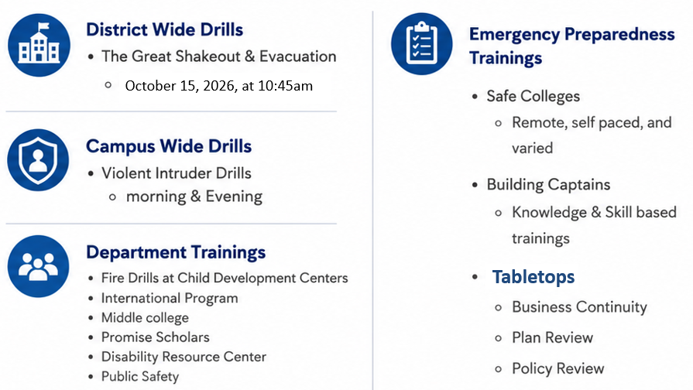

Safety & Emergency Preparedness Trainings

Slide 20
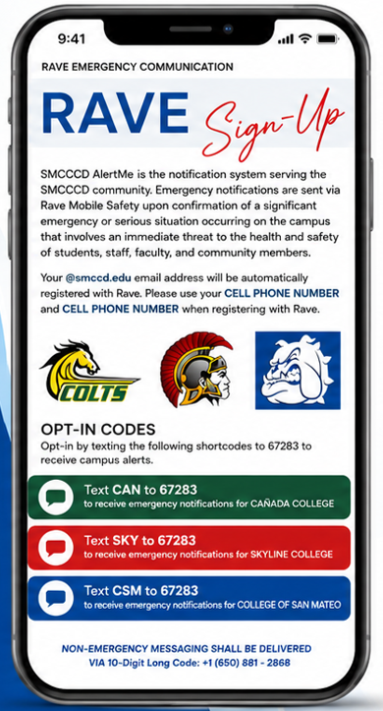
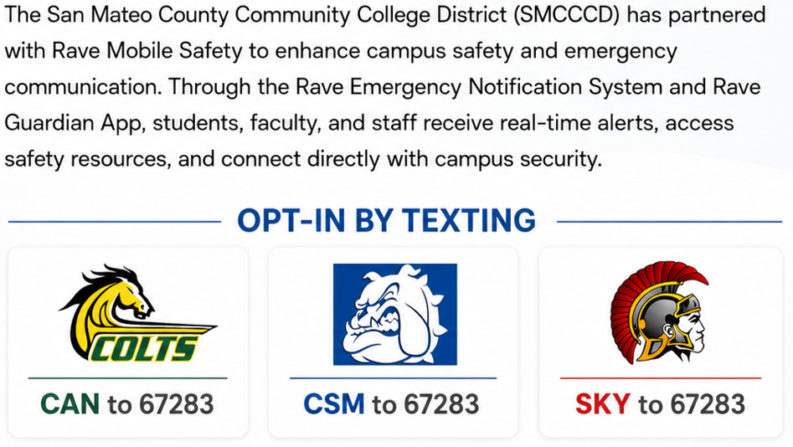
RAVE Notification
Please use your CELL PHONE NUMBER and NOT a LANDLINE NUMBER when registering with Rave.

Slide 21
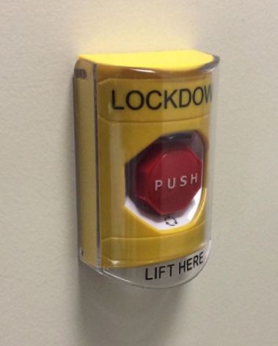
Public Safety Technology
Video Cameras
  800+ District Wide
ACAMs
  Employee Photo ID
  1,281 Points District Wide
AEDs
  70+ Units District Wide
911 System
Duress Buttons
  Text
  Email
  66 District Wide (CSM 38, CAN 14, SKY 14)
Lockdown Button

Slide 22
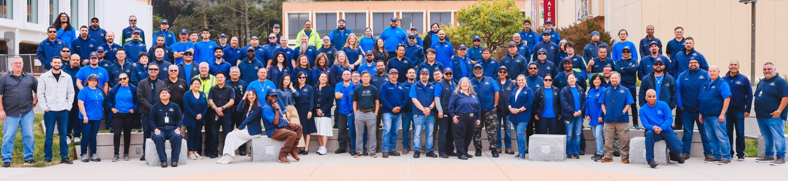
ONE TEAM!
NEW PHOTO
Facilities Excellence = Customer Service * Professionalism * Team Work * Communication
Public Safety Excellence = Safety * Education * Service

Slide 23

Facilities Planning,
Maintenance & Operations
"Facilities & Public Safety Excellence"

