Slide 1

BUDGET PRESENTATION
AFT Negotiations session
April 25, 2025

Slide 2

BUDGET PRINCIPLES
Address Board goals and District Strategic Plan
Balanced budget projections
  Trade Offs
Maintain adequate reserves pursuant to Board Policy 8.11
Use one-time funds for one-time expenses
Support College budgeting priorities in accordance with participatory governance protocols and accreditation standards
Notes:
Balanced Budget = add more resource to one thing than a reduction is needed for something else
RA Assumes a 3% COLA for 2025-26 based upon available resources
By default, any additional COLA would erode site allocations – trade offs

Slide 3
2025-26 STATE BUDGET proposal
Balanced Budget with Considerable Uncertainty
    Federal Government Policy Changes
    State Capital Gains Tax Receipts
    Impact of Los Angeles County Wildfires
Significant Focus on Master Plan for Career Education
Shaped by the Roadmap for the Future
Community Colleges ($782.07 Million)
  $358.55 Million Ongoing
  $423.52 Million One-Time
WILL KNOW MORE IN MID-MAY WHEN THE GOVERNOR PROPOSES HIS REVISED 2025-26 STATE BUDGET PROPOSAL
Notes:
The Master Plan for Career Education includes the following six primary plans of action:
Create a statewide planning and coordinating body to bring together education, workforce training providers, and employers.
Evaluate how successful regional training models can be expanded to create sustainable forums for educators, workforce training providers, and employers.
Make it easier for employers to make hiring decisions based on individuals’ skills in addition to their academic credentials.
Push for universal availability and implementation of pathways programs to provide students from all backgrounds with clear roadmaps to gainful employment.
Ensure access to education, workforce training, and jobs that allow adults and young people to advance in stable, well-paying career pathways.
Ensure that all eligible learners from all backgrounds can easily access education, workforce training, and public benefits that open doors to rewarding, well-paying jobs.

Slide 4
State Budget Proposal community colleges ongoing
Ongoing ($358.55 Million)
  $230.39 Million to Fund a 2.43% Cost-of-living-adjustment (COLA) for the Student-Centered Funding Formula (SCFF)
  $28.69 Million to Fund a 2.43% COLA for Certain Categorical Programs
  $30.44 Million to Fund .5% Enrollment Growth for the SCFF
  $30 Million to Expand the Rising Scholars Network
  $29 Million for the Creation of a Common Cloud Data Platform
  $7 Million to Expand Credit-for-prior-learning Policies
  $2.44 Million for Lease Revenue Debt Service Adjustments
  $1.7 Million for Financial Aid Administration
  $1.11 Million Reduction in Equal Opportunity Funding
Notes:
Categorical Programs w/ COLA: DSPS, EOPS, Apprenticeship, CalWORKS, Mandated Cost Block Grant, CARE
SCFF – Does not apply

Slide 5
State Budget Proposal community colleges one-TIME
One-Time ($423.52 Million)
  $168.02 Million for Transformation to Statewide Technology
  $133.5 Million for the Creation of a Common Cloud Data Platform
    In Addition to the $29 Million Ongoing
  $93 Million to Expand Credit-for-prior-learning Policies
    In Addition to the $7 Million Ongoing
  $29 Million Technical Adjustment for the SCFF
  NO FUNDING PROPOSED FOR SCHEDULED MAINTENANCE
  Funding for Skyline College’s Boiler Replacement Project
Notes:
Proposed funding from Proposition 2: Boiler Replacement Project at Skyline College in the amount of $454,000 for 2025-26, with an expectation that the State provide an additional $5.6 million in subsequent years towards the total project cost of $8.1 million.

Slide 6
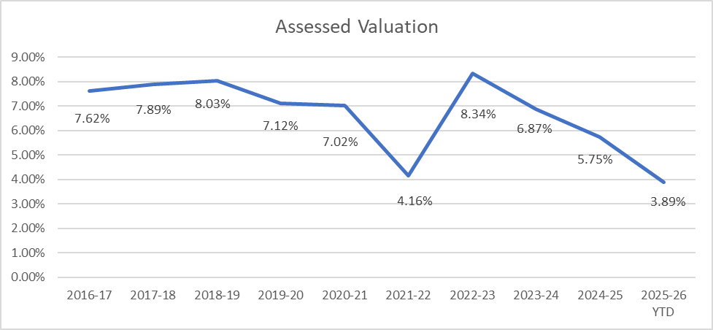
Notes:
2025-26 Estimated at 5%
Takes Approximately 4% to cover year-over-year costs exclusive of any COLAs
2021-22 – Pandemic / Properties were not turning over, which minimizes increases to assessed valuation
2026-27 = 5.25%
2027-28 = 5.50%

Slide 8
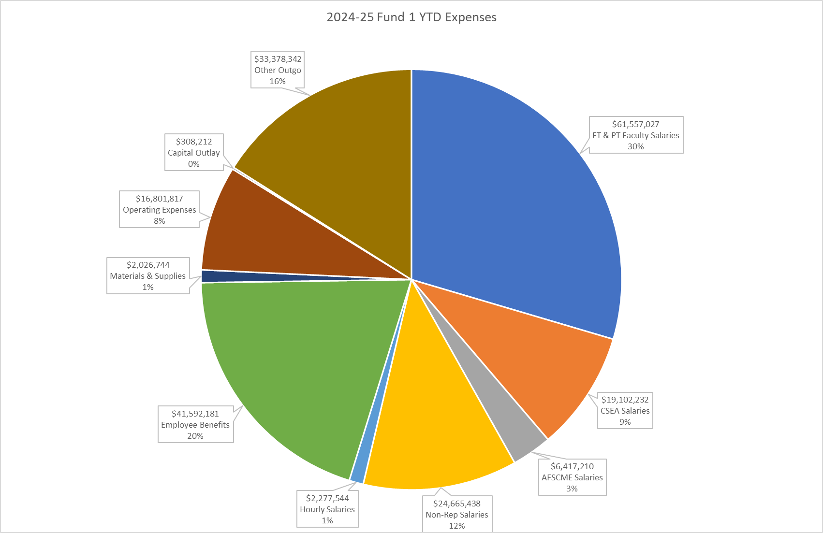
Notes:
YTD = 75% of expenses are personnel related
Non-Reps:
Executives
Managers
Supervisors
Confidentials
Other Outgo:
SB893
Transfers for Insurance
Transfers for Parking Fund
Transfers for Health Services
Transfers for PSP
Transfers to Capital Outlay Fund

Slide 9
Looking ahead
Declining Assessed Valuation Trend
Economic Volatility
Cost Escalations (Inflation)
  Insurance
  Utilities
  Technology
  General Operating Expenses
Enrollment Trends

Slide 10
Questions?
Thank You!

